Slide 1
CVP Water Temperature Modeling Platform
Modeling Technical Committee Meeting 1
July 1, 2021; 1 – 4 pm

Slide 2
Welcome!!
We are looking forward to a productive meeting, please consider –
Remote meeting. Remote collaboration meetings can be challenging and frustrating, especially with larger groups – please be patient and flexible​. If you are having technical difficulties, please chat with Sarah Hamilton.
Chat Panel will be used for participants to provide comments and ask questions. Use Raise Hand functions in Q&A session.
Agenda includes presentation and Q&A sessions

Slide 3
Workshop Agenda
1:00 Meeting Logistics and Welcoming Remarks
Yung-Hsin Sun, Stantec
David Mooney/Kristin White/Derya Sumer, Reclamation
1:15 WTMP Overview and Orientation for the MTC (including 5 min Q&As)
Randi Field, Reclamation
Mike Deas, Watercourse/Yung-Hsin Sun, Stantec
2:00 Break
2:05 Water Temperature Model and Framework Review and Selection, Part 1: Models and Framework
Randi Field/Mike Deas/John DeGeorge
3:10 Break
3:15 Water Temperature Model and Framework Review and Selection, Part 2: Initial Application
Randi Field/Mike Deas/John DeGeorge
3:45 Wrap Up and Next Steps
Sabrina Cook
4:00 Adjourn
Objective:
Kickoff the MTC process to collaborate the WTMP development, covering the Sacramento, American and Stanislaus river systems.

Slide 4
Registration Poll
What is your primary interest in joining the MTC meetings?
Will update on Wednesday evening for latest statistics.

Slide 5
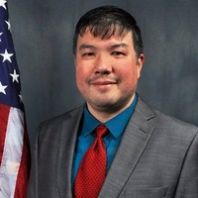
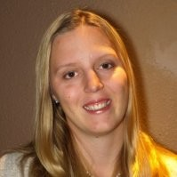
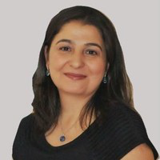
Opening Remarks
David Mooney Office Manager Bay Delta Office Region 10 – California-Great Basin | Kristin White Operations Manager Central Valley Operations Office Region 10 – California-Great Basin | Derya Sumner Water Supply and Operations Analysis Branch Chief Division of Planning Region 10 – California-Great Basin
Executive Sponsor | Alternate

Slide 6
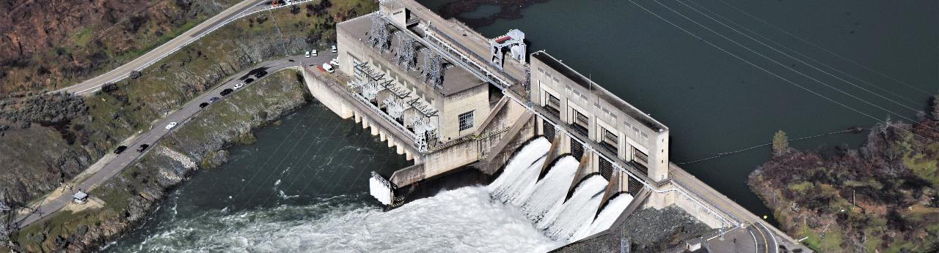
WTMP Overview - Project Needs and Anticipated Outcome
Randi Field, Civil (Hydrologic) Engineer, CVO

Slide 7
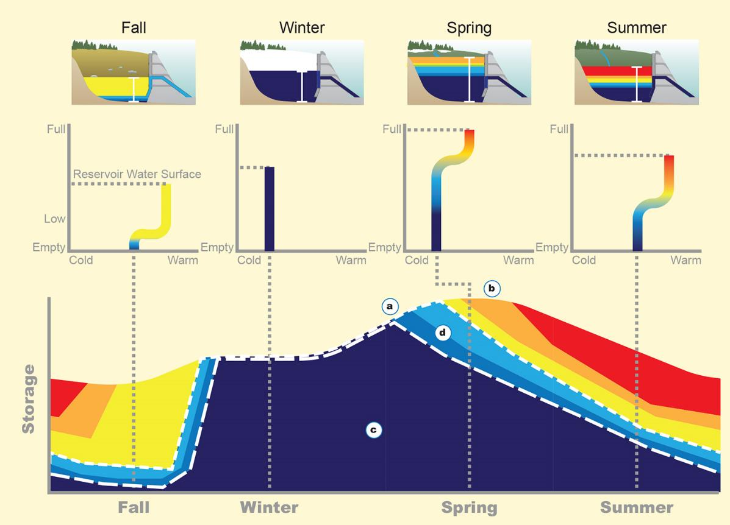
Water Temperature Management Story

Slide 8
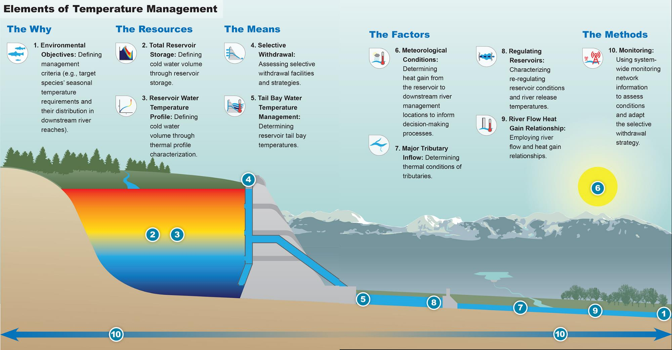
Water Temperature Management Story
Reference: Reclamation, 2017. Water Temperature Management in Reservoir-River Systems through Selective Withdrawal, Reference Technical Memorandum for Central Valley Project Operation, California. September.

Slide 9
Modernize Business Practice to Support the CVP Operations
Expect high quality
Build trust and confidence
Optimize flexibility
Design for compatibilities/efficiencies
Plan for long-term maintenance/support horizon
Enhance within agency expertise

Slide 10
Need high Quality
Objective: Raise standards
Requirements:
Documentation: Robust - Transparency
Assumptions: Explicit
Demonstrate Performance: Continuous Testing – How well does the model work?
Notes:
Resources management tight – improve the quality for better decision making

Slide 11
Need Confidence -tools add value, are useful, and trusted
Objective: Open process
Requirements:
Access: Transparency – Share
Clarify Limitations: Informed consumer
New Data: Continual Improvements
Collaborative Forum: Modeling Technical Committee
Demonstrate Performance: Testing
Peer Review: Independent evaluation
Notes:
People make decisions
Example Weather forecast
Continuum

Slide 12
Need Flexibility to respond
Objective: Embrace change
Requirements:
Accessible Model: Modify code and adapt to change
Modeling Modes: Address both real-time, seasonal and long-term planning
Risk and Uncertainty Assessment: New capabilities
Notes:
AAA
Race car vs 4x4 rock crawler

Slide 13
Need Compatibility and Efficiency for practical applications
Objective: Leverage technology
Requirements:
Framework: Robust structural organization/compatibility
Model Setup and Organization: Consistency
Data Management: Essential
Streamline Procedures: Ease of use and error reduction
Apply time saving techniques: Automate tasks when appropriate
Modeling Modes: Address both real-time, seasonal and long-term planning

Slide 14
Need to build tools for Longer-time Horizons
Objective: Adapt to current funding and contracting constraints
Requirements:
Design for Change: Anticipate future needs
Build Institutional Knowledge: Empower staff
Notes:
–get ahead of the curve

Slide 15
Need to develop Expertise
Objective: A broad user base fosters longevity
Requirements:
Investment: Build knowledge base
Organization capacity building: Empower staff
Notes:
Want investment to last the long haul
Fact Sheet

Slide 16
Vision for WTMP Project
Goal: Deliver quality products to support Reclamation’s mission – predict water temperature to support CVP operations
Modernize Systemwide Water Temperature Modeling and Analytics
Develop to Professional Standards – foster transparency
Consistency cross uses: Real-Time, Seasonal, and Long-term Planning
Accommodate technological advancements
Notes:
Facts Sheet – include consistent messages

Slide 17
Modeling Technical Committee (MTC)
Positive Experience for Shasta-Keswick W2 model development experience (2016 – 2020)
Community-based collaborative model development
Request your support and collaboration, leveraging your technical expertise and passion:
Consistent engagement
Timely project product review as available
Constructive input and comments
(if all work well…) Future user group on water temperature modeling
More information later
Notes:
Synergy not a buzz word

Slide 18
WTMP Overview - Workplan and Schedule
Mike Deas, Watercourse Engineering

Slide 19
Presentation Overview
Technical Charge
Project Area
Tasks
Phase I
Phase II
Project Schedule
Current Status and Next Steps

Slide 20
Technical Charge
Develop tools to support Reclamation’s water temperature management activities
Data management
Model development
Model management (framework)
Model Reporting
Documentation
Other
Representative, Useful, Relevant, Longevity

Slide 21
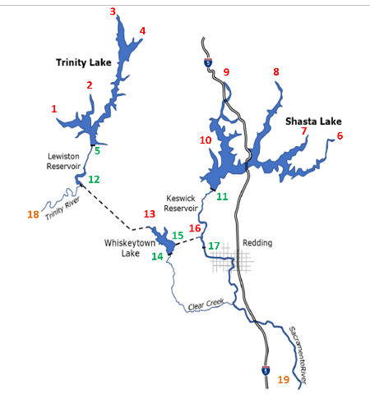
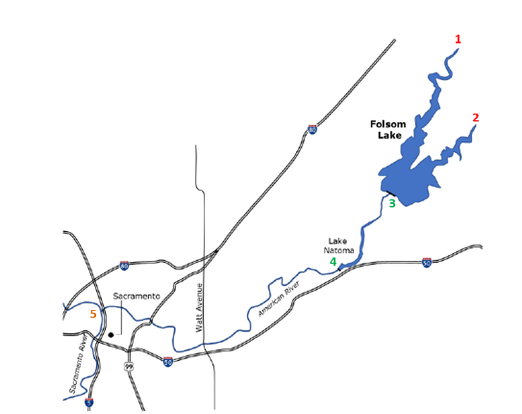
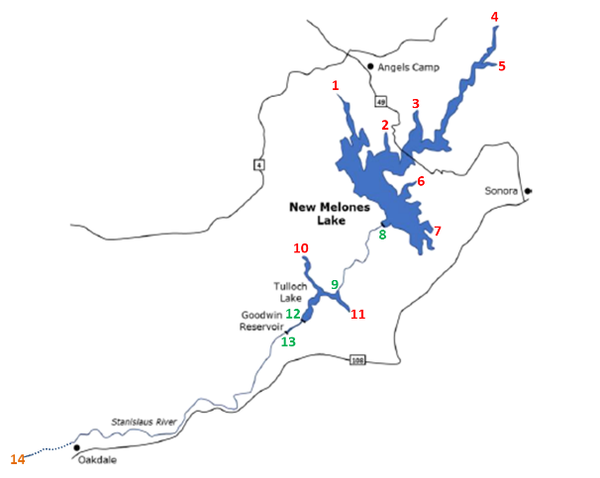
Project Area
Sacramento/Trinity, American, Stanislaus Rivers

Slide 22
Tasks
Phase I
Project Organization
Model Development
Phase II
Model Implementation
Peer Review

Slide 23
Project Elements
Workplan
(Phase I)
Stakeholder Outreach
Institutional Knowledge
Data
Management
Model
Framework
Model
Selection
Data
Development
Model
Development
Model
Calibration/ Validation
Model
Documentation
(Phase I)
Workplan
(Phase II)
Model Implementation
Source of
Uncertainty
Output Communication
Phase II Documentation
Peer Review
Support

Slide 24
Phase I
Task | Objective
Task 1. Project Workplan | Develop workplan and schedule for the overall modeling project with emphasis on Phase I – Task 1 through Task 10
Task 2. Stakeholder Involvement and Outreach | Outreach activities
Task 3. Develop Reclamation’s Institutional Knowledge | Technology transfer
Task 4. Data Management | Develop data management plan for Phases I and II of project
Task 5. Model Framework Design and Refinement. | Develop a system-wide model framework for use throughout project area
Task 6. Model Selection/Design | Select models for each of the elements of the framework
Task 7. Data Development | Identify necessary input data to models and obtain necessary data
Task 8. Model Development | Develop and revised or refined models
Task 9. Calibration, Validation, and Sensitivity | Calibrate and validate models
Task 10. Documentation Phase I | Documentation of Phase I model development

Slide 25
Phase II
Task | Objective
Task 11: Phase II Workplan | Develop a detailed workplan and schedule for Phase II – Task 11 through Task 17
Task 12: Implementation | Determine schedule for downstream/in-river simulation, real time/seasonal, and planning applications
Task 13: Estimation of Uncertainty – Sources | Develop and communicate sources of uncertainty in estimates of water temperature downstream of regulating reservoirs.
Task 14: Estimation of Uncertainty – Protocols | Develop and communicate protocols for estimating uncertainty bounds in estimates of water temperature downstream of regulating reservoirs. Task 14 will be combined with Task 13
Task 15. Output Communication | Develop output communication/visualization tools and data presentation approaches
Task 16: Documentation – Phase II | Documentation of Phase II activities
Task 17. Peer Review | Provide support for peer review of model components and overall framework.

Slide 26
Project Schedule
Model and Framework Selection Summer 2021
Model Development
Sacramento Spring 2022
American Fall 2022
Stanislaus Winter 2022/23
Phase II Tasks
Workplan Fall 2021
Uncertainty sources and protocols summer 2022 ->
Output/communications Fall 2021
Documentation (task and system specific)

Slide 27
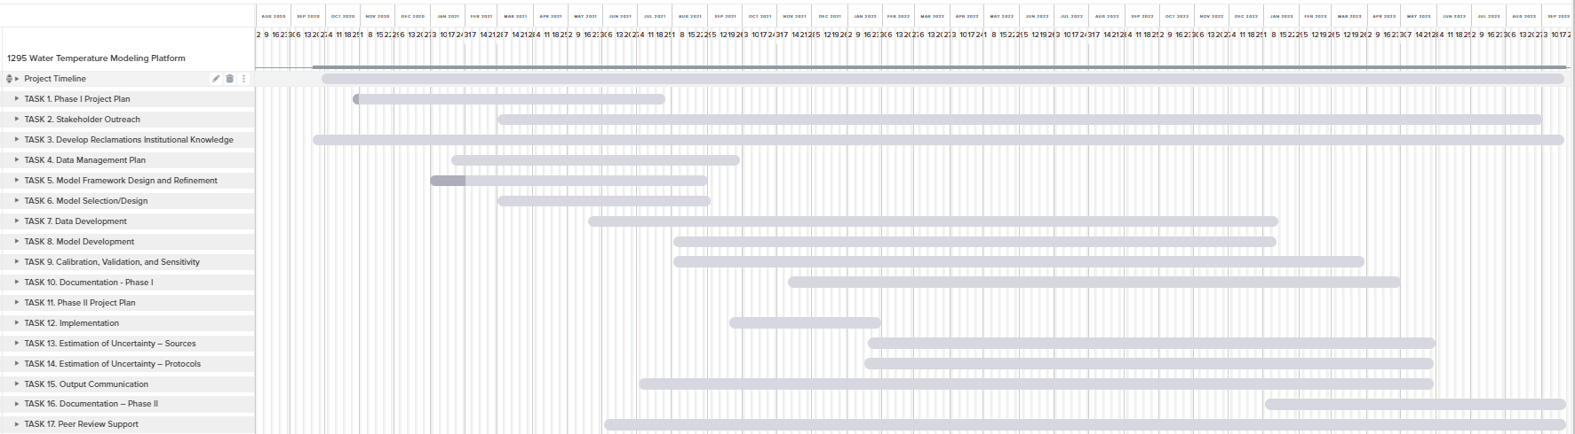
Project Schedule (Example, STC)
9/2023
2021
2022
2021
2022
2023

Slide 28
Current Activities
Task 1: Workplan (Draft)
Task 2: Community Participation Plan (Draft)
Task 3: Technology Transfer (ongoing)
Task 4: Data Management Plan (Draft)
Task 5: Model Framework (Draft)
Task 6: Model Selection (Draft)
Task 17: Peer Review

Slide 29
Next Steps
Task 7: Data Development
All Basins
Task 8: Model Development
Sacramento/Trinity
American
Stanislaus
3-month and 12-month “look ahead”

Slide 30
WTMP Overview - MTC Orientation and Expectation
Yung-Hsin Sun, PhD, PE, Stantec Consulting Services Inc.

Slide 31
Modeling Technical Committee (MTC)
Despite of its name, it is more an open forum for collaborative model development.
Technical focused discussions centering around water temperature modeling tools, data and applications.
Scheduled quarterly meetings – First Thursday (1 – 4 pm) of the first month of each calendar quarter till the end of 2023
In-person meetings are possible in the future (TBD); online participation is always provided.
Registration for individual meeting is required. The agenda will be distributed ahead with notification.
Additional email communication for updates, information sharing and product review requests.

Slide 32
Overall Project Stakeholder Involvement
Project contract: mppublicaffairs@usbr.gov
Project Website (under development)
Modeling Technical Committee (MTC) – Quarterly
Manager Briefings – Annual
More information to come
Stakeholder SharePoint Site

Slide 33
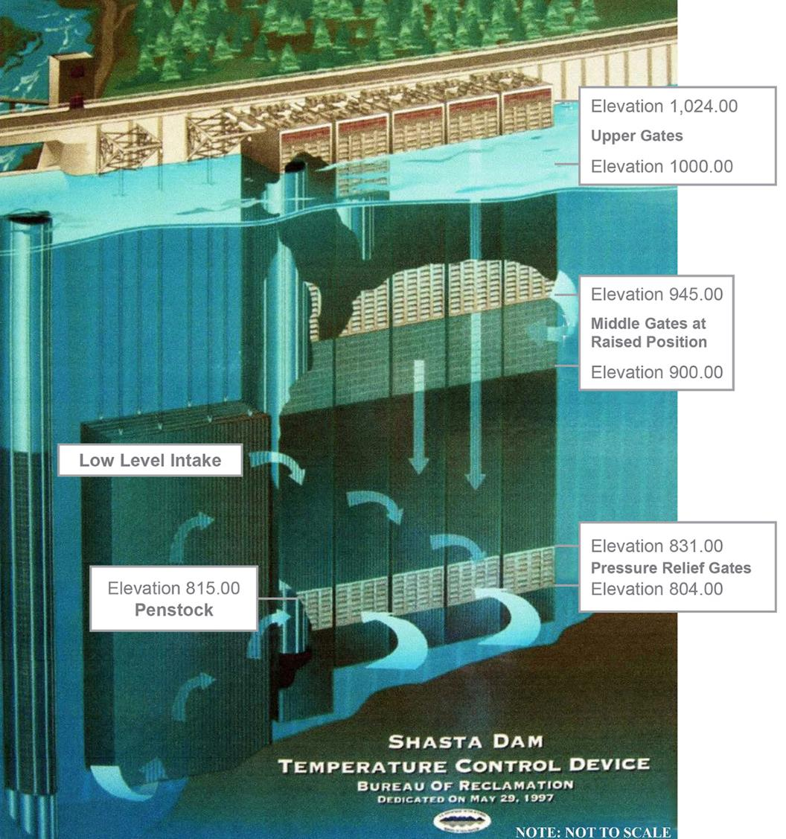
Questions

Slide 34

Short Stretch Break

Slide 35
Water Temperature Model and Framework Review and Selection - Part I: Models and Framework
Randi Field, Civil (Hydrologic) Engineer, CVO

Slide 36
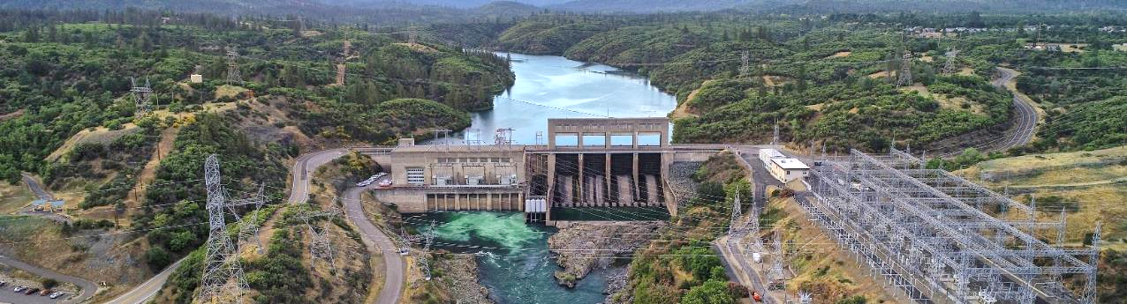
Water Temperature Model and Framework Review and Selection - Water Temperature Model Selection
Photo credit: John Hannon, Reclamation
Mike Deas, PhD, PE, Watercourse Engineering, Inc.

Slide 37
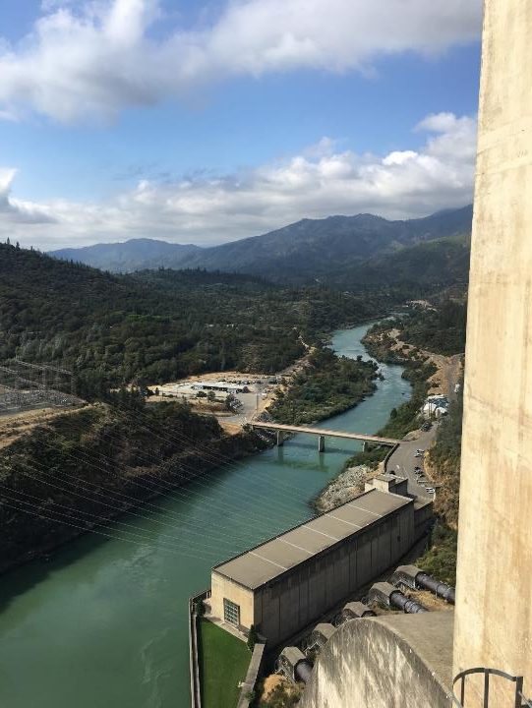
Presentation Overview
Task Description
Model Selection Criteria
Models
Model Selection

Slide 38
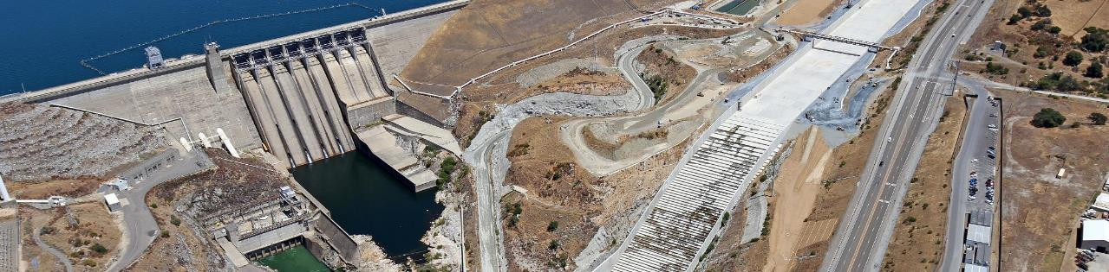
Model Selection/Design (Task 6)
Select models for each of the elements of the framework based on objectives and selection criteria. Determine the appropriate spatial and temporal resolution of the selected models, and conduct any additional necessary design specification for the models.

Slide 39
Model Selection Criteria
Purpose: screen potential models for selection and implementation in the Water Temperature Modeling Platform (WTMP)
28 model criteria developed
Grouped into subcategories
Each criterion assessed, where feasible, as high, medium, or low priority
Criterion identified as “required” and “preferred”
Selection criteria are important and necessary to ensure models fit project need

Slide 40
Modeling Need(s)
Relatively computationally efficient, but accurate, reservoir-river model to support
Reclamation’s annual temperature management planning activities (Sacramento River, American River)
Planning level analyses requiring long-term simulations (e.g., CALSIM 80+ year hydrology), ensemble analyses, Monte Carlo analyses, or similar)
Refined models to capture selected elements with higher resolution to represent key features that may not be completely represented in a simpler model representations.

Slide 41
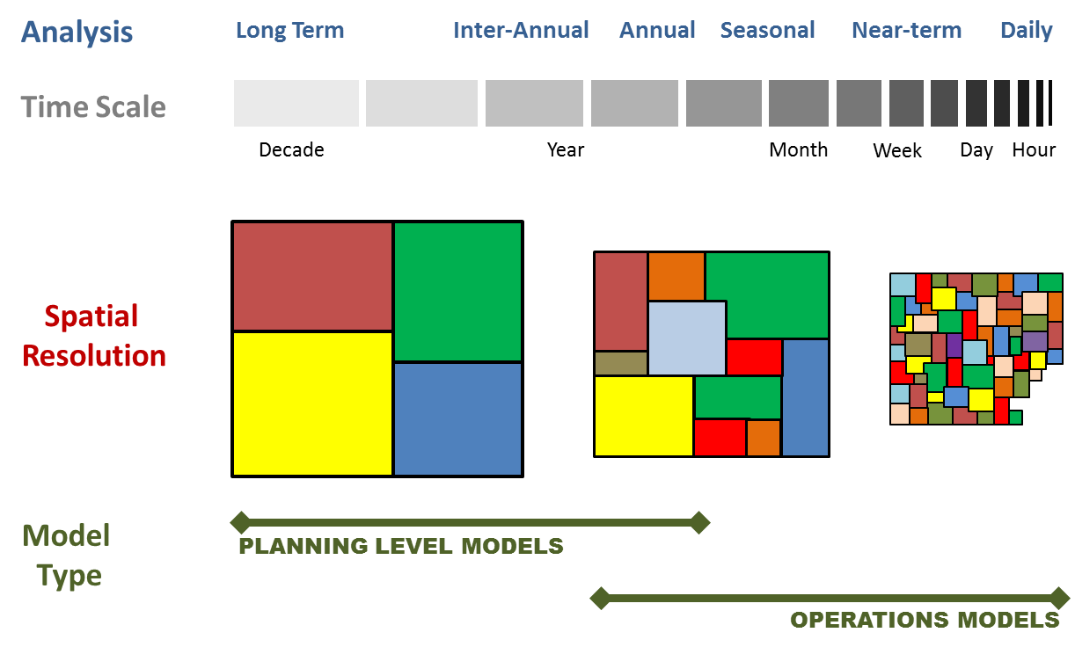
Model Spatial and Temporal Considerations

Slide 42
Model Types/Definitions
System Model
Element Model
Modeling Framework
0
●
●
●
●
●
●
●
●
●
●
●
●
●
●
●
●
●
●
●
●
●
Reservoir
River
Conveyance (e.g., tunnel, canal)
Linkage between model reaches (reservoir, rivers, diversions)
●

Slide 43
Model Selection Criteria: Subcategories
Numerical Model Criteria – representation of physical system in a model
Linkage – addresses if models are discrete (reach specific) or system-wide and if framework compatible
Input/Output (I/O) – model pre- and post-processors and data structures
Support – user specific information
CVP Features – ability to represent specific features CVP
Qualitative – additional qualitative criteria

Slide 44
Numerical Model Criteria
Criteria | Notes/Comments | Priority
1. Model type (River/Reservoir) | Reservoir (vertical profile and outflow temperature), River (longitudinal temperature) | H
2. Number of dimensions (1, 2) | Tradeoffs between lower/higher dimensional representations and computational efficiency | H
3. System geometric representation | Appropriate spatial resolution to represent reservoir/river element | H
4. Dynamic flow model | Ability to capture flow conditions over a range of time scales (hours, days, months) | H
5. Water temperature representation | Comprehensive heat budget formulation | H
6. Time step | Sub-daily required | H
7. Computational performance consideration | Computation time considered for screening analyses as well as planning analyses | H

Slide 45
Linkage Criteria
Criteria | Notes/Comments | Priority
8. System Model or discrete reach | Model can represent entire system (reservoir and river hydrology and water temperature) or a discrete segment/element of system (e.g., reservoir model) | M
9. Modeling framework compatible | Model can share I/O with other models in a framework | H/M

Slide 46
Input/Output (I/O) Criteria
Criteria | Notes/Comments | Priority
10. Pre-processor | Assess and manage inputs | H
11. Post-processor | Assess, visualize, and report output (graphical and tabular) | H
12. Data structure facilitates model calibration/application | To facilitate modeling, calibration, and error detection | L
Input
Model
Output

Slide 47
Support Criteria
Criteria | Notes/Comments | Priority
13. Model applications | Model been used in applications similar to this project. | H
14. Actively supported | Actively supported models | H
15. Public domain, peer reviewed, and accessible model modifications | To assess critical model assumptions, verify model modifications, and provide model transparency | H
16. Fee | Model is free or is there a minimal cost for software | H
17. Documentation | Technical reports on model construction (equations, solution methods, testing) and user manuals | H
18. Training and/or user group | Support ongoing model application | M/L

Slide 48
CVP Features Criteria
Criteria | Notes/Comments | Priority
19. Specific features: | Represent current or planned project facilities
A. Temperature control curtains | Lewiston Lake and Whiskeytown Lake | H
B. Submerged weirs/dams | Submerged dam upstream of New Melones Dam | H
C. Selective withdrawal | Shasta Lake and Folsom Lake | H
D. Automated simulations to target tailbay temperature | Model target reservoir release temperatures | H
E. Automated simulations to target river temperature | Model target downstream river temperatures | H
F. Shade | Topographic and/or riparian vegetation shade | M

Slide 49
Qualitative Criteria
Criteria | Notes/Comments | Priority
20. Qualitative
A. Ease of use | Relatively easily operated (data input, model run, and output accessed) | M
B. Credibility | A history of successful use and previous peer review or institutional review/support | H
C. Easy to incorporate uncertain input parameters | External (preferred) rather than internal | M
D. Collaboration with model developers | Model developers have an interest in collaboration | M

Slide 50
Model Selection
Model Selection Criteria
Numerical Model
Support
CVP Features
Qualitative
I/O
Linkage
Modeling Objective(s)
Model Types
System
Element
Reservoir
River
Framework approach

Slide 51
Reservoir and System Models
Model | Sponsor | Type
CE-QUAL-W2 | PSU, USACOE | Reservoir
DYRESM | CWR-UWA | Reservoir
HEC-5Q | USACOE | System
HEC-ResSim | USACOE | System
Riverware | CADSWES | System
CADWES: Center for Advanced Decision Support for Water and Environmental Systems CWR-UWA: Center for Water Resources, University of Western Australia PSU: Portland State University USACOE: US Army Corps of Engineers

Slide 52
River Models (1/2)
Model | Sponsor | Type
CE-QUAL-RIV1 | USACOE | River
EPD-RIV1 | GEPD | River
Heat Source | ODEQ | River
HEC-5Q | USACOE | System
HEC-RAS | USACOE | River
HEC-ResSim | USACOE | System
QUAL2K | Tufts Univ., USEPA, WDOE | River
GEPD: Georgia Environmental Protection Division ODEQ: Oregon Department of Environmental Quality USACOE: US Army Corps of Engineers USEPA: US Environmental Protection Agency WDOE: Washington Department of Ecology

Slide 53
River Models (2/2)
Model | Sponsor | Type
RAFT | NOAA-SFSC | River
RBM10 | USEPA | River
River Modeling System(RMS) | Loginetics | River
Riverware | CADSWES | System
RMA2/RMA4 | Aqueveo | River
CADWES: Center for Advanced Decision Support for Water and Environmental Systems NOAA-SFSC: National Oceanic and Atmospheric Administration-Southwest Fisheries Science Center USACOE: US Army Corps of Engineers USEPA: US Environmental Protection Agency

Slide 54
Initial Selection
Assessed each criteria
(Y/N, H/M/L)
Yes and Yes*
Required (R), Preferred (P)
Unknown, n/a
Quantitative and Qualitative

Slide 55
System Model: HEC-ResSim
Non-uniform flow, non-steady state flow
Full heat budget
Selective withdrawal (tailbay target)
Sub-daily time step
Monte Carlo and Ensemble analyses
Incorporate new logic via “plug-ins”
Interface with other models (e.g., CE-QUAL-W2)
Operate as a stand-alone model or as part of a modeling framework
Pre- and post-processors
Comprehensive documentation (model, pre- and post-processors)
Active support (model, pre- and post-processors)
Access to the model developers, collaboration
User groups, training
Other

Slide 56
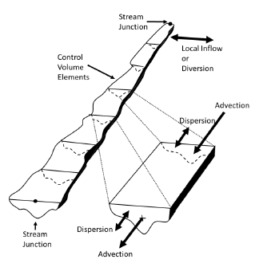
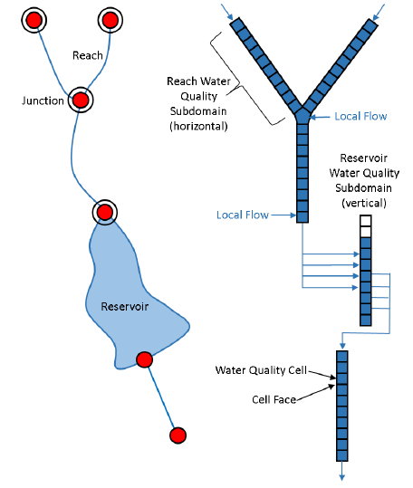
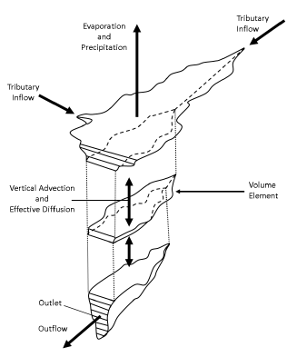
System Model: HEC-ResSim
Reservoirs (1-D)
Vertical gradients
Laterally and longitudinal averaged
River (1-D)
Longitudinal gradients
Laterally and vertically averaged

Slide 57
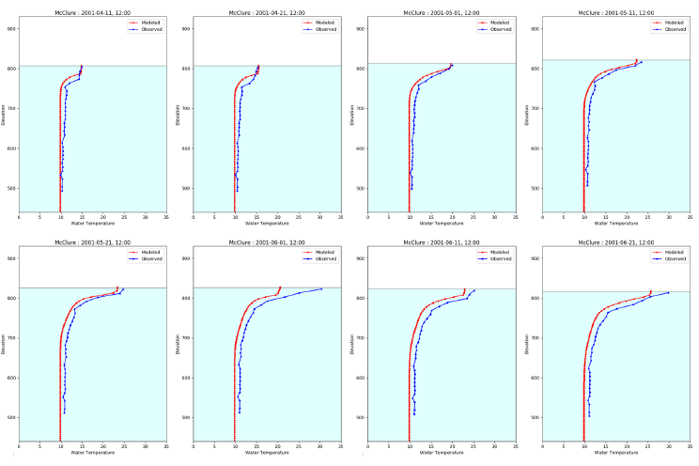
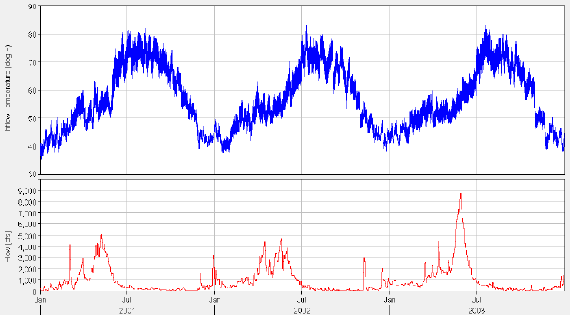
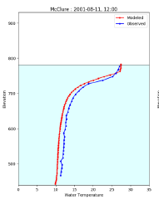
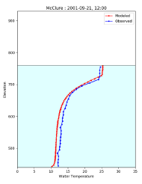
Model Output
Reservoir Outflow (time series)
Reservoir Stage (time series)
Outflow Water Temperature (time series)
Vertical Temperature Profiles

Slide 58
Reservoir Model: CE-QUAL-W2
Two-dimensional representation
Non-uniform flow, non-steady state flow
Full heat budget
Selective withdrawal (tailbay target)
Sub-daily time step
Supports branching networks (e.g., dendritic nature of reservoir)
Existing applications (Shasta, Keswick, Lewiston, Folsom, Natomas)
Pre- and post-processors
Comprehensive documentation (model, pre- and post-processors)
Active support (model, pre- and post-processors)
Access to the model developers, collaboration
User groups, training
Operate as a stand-alone model or as part of a modeling framework
Other

Slide 59
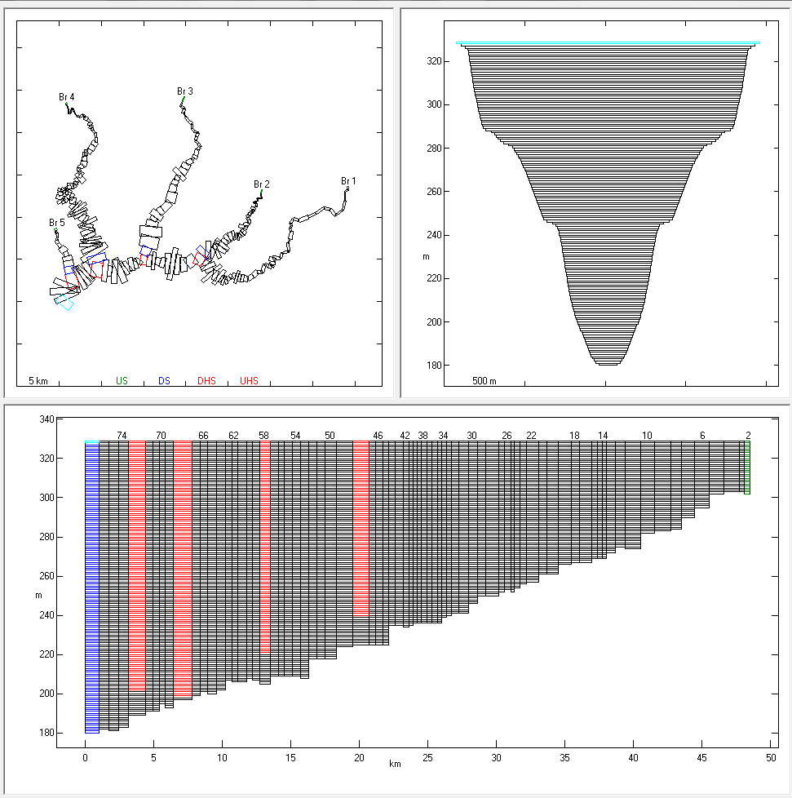
Reservoir Model: CE-QUAL-W2
Reservoirs (2-D)
Vertical gradients
Longitudinal gradients
Laterally averaged

Slide 60
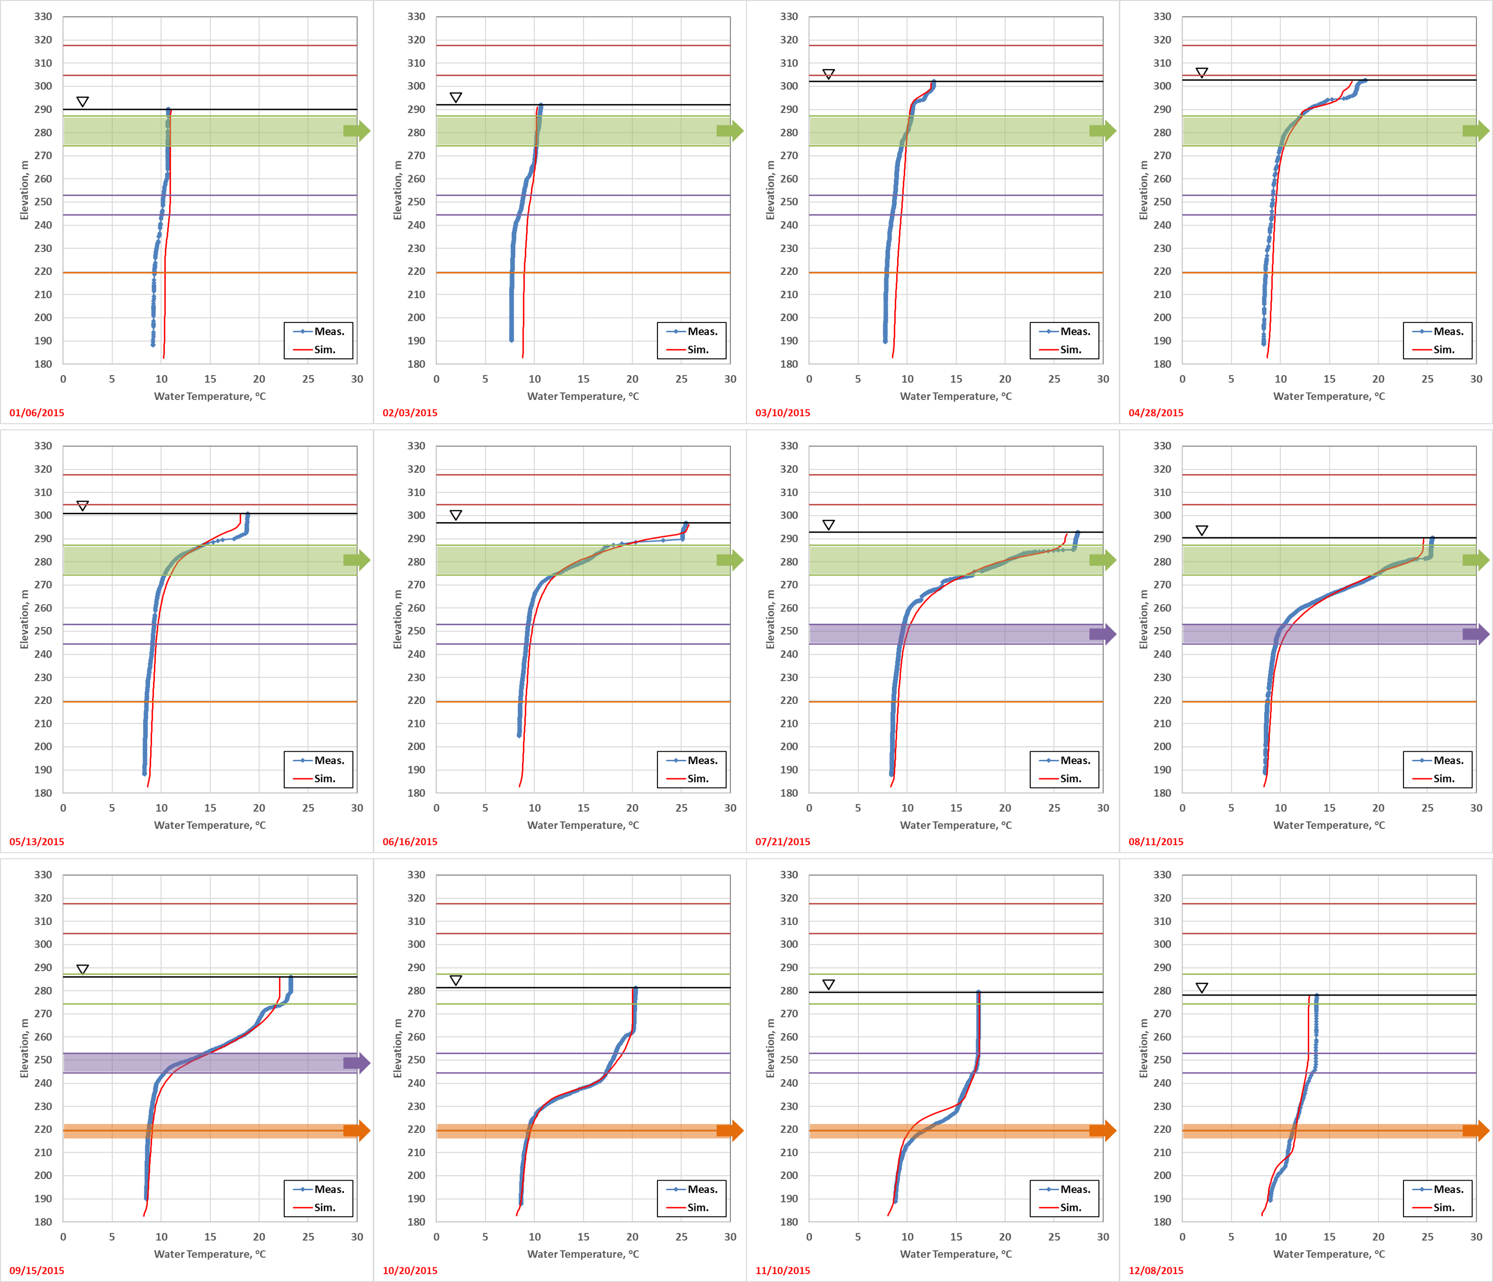
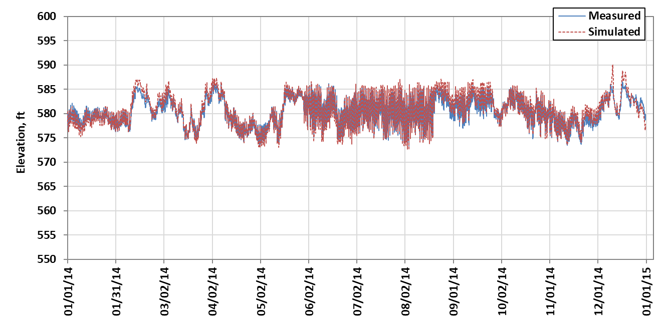
Model Output
Reservoir Outflow (time series)
Reservoir Stage (time series)
Outflow Water Temperature (time series)
Vertical Temperature Profiles

Slide 61
River Model: HEC-ResSim
River representation (1-D)
Longitudinal gradients
Laterally and vertically averaged
Consistent with current river temperature modeling approach in all systems
Attributes previously discussed

Slide 62
Summary
Developed model criteria
Identified prospective models
Selected models
Initial Model Selection:
System: HEC-ResSim
https://www.hec.usace.army.mil/software/hec-ressim/
Reservoir: CE-QUAL-W2
http://cee.pdx.edu/w2/
River: HEC-ResSim

Slide 63
Water Temperature Model and Framework Review and Selection - Modeling Framework Selection
Photo credit: John Hannon, Reclamation
John DeGeorge, Ph.D., P.E., RMA

Slide 64
Modeling Framework Selection - Overview
Purpose of a Modeling Framework
Team Roles
Candidate Frameworks
Selection Criteria
Framework Comparison
Selection

Slide 65
Overview of Framework and Objectives
Enhance Efficiency, Consistency, Adaptability and Transparency
Ease model application and output interpretation
Reduce requirement for training on file editing and information flow
Reduce the time it takes to carry out modeling activities
Facilitate standard approaches for data management and reporting
Automate repetitive modeling tasks
Facilitate the use of multiple models individually or in a sequence
Managing updates and addition of new features
Reducing input error and errors in general!

Slide 66
Model, Configuration, Input and Output
“Model” in this context refers to a computational software program, for example:
CE-QUAL-W2
HEC-5Q
HEC-ResSim
CALSIM II
DSM2
…
Model Input
Boundary Conditions
Operations, Simulation Options
Model developer is responsible for the computational engine source code and establishing input/output formats
Model Configuration Information
Geometry
Parameters
Options
Model
Computational Engine
Model Output
Time Series, Spatial Output
Logs and supporting output

Slide 67
Team Roles
Model Developer
Responsible for the development and maintenance of a model’s computational engine
Expert Modeler
Responsible for configuration and calibration of a model for a particular system
Power User
Configures automated processing for pre- and post- processing, designs reports, manages model linkages
Model Operator
Carries out modeling studies
IT Support
Manages the IT infrastructure to facilitate team modeling and provide connectivity to web data sources

Slide 68
Operational Use of a Model
Time Dependent Data:
Meteorology, Inflow, Inflow Temperature, Operations
Pre-Processing
Model Input
Physical Data:
Topo/Bath Surveys, Outlet configurations, channel capacity
Done for every run by Model Operators
Model Configuration
Model
Configuration and Calibration
Model Output
Post-Processing
Done periodically by Expert Modelers
Plots, Tables, Result Summaries

Slide 69
A Single Model in a Modeling Framework
Time Dependent Data
Modeling
Framework
Automated Pre-Processing
Model Input
Power User establishes automation
Physical Data
Configuration and Calibration
Model Configuration
Model
Model Output
Automated Post Processing
Processed Results

Slide 70
Automating Standard Inputs and Outputs
Historical Observations
Forecasted Conditions
Planning Studies
Other Sources
Modeling
Framework
Automated Pre-Processing
Model Input
Power User with IT Support can expand the range of standard input and output
Physical Data
Configuration and Calibration
Model Configuration
Model
Model Output
Automated Post Processing
Visualization
Reports
Output Repository
Data Export
Excel, CSV, DSS…

Slide 71
Multiple Models in a Framework
Historical Observations
Forecasted Conditions
Planning Studies
Other Sources
Modeling
Framework
Automated Pre-Processing
Automated Pre-Processing
Automated Pre-Processing
Model 3
Model 1
Model 2
Model 4
Automated Pre-Processing
Automated Pre-Processing
Automated Post-Processing
Visualization
Reports
Output Repository
Data Export
Excel, CSV, DSS…

Slide 72
Candidate Frameworks
Type | Name |  | Primary Author | Description | Link
Application Programming Interface | OpenMI | Open Modeling Interface | OpenMI Association | defines API to be implmented by a model | https://www.openmi.org/
 | BMI | Basic Model Interface | University of Colorado | defines API to be implemented by a model "wrapper" | https://csdms.colorado.edu/wiki/BMI
Software Platform | OMS3/CSIP | Object Modeling System | Colorado State University | interoperable and lightweight modeling framework for component-based model and simulation development on multiple platforms | https://alm.engr.colostate.edu/cb/project/oms/
 | ESMF | Earth System Modeling Framework | NASA, NOAA, NCAR, DoD | high-performance, flexible software infrastructure for building and coupling weather, climate, and related Earth science applications | https://earthsystemmodeling.org/
 | HydroCouple |  | University of Utah | cross platform component-based modeling framework for integrated modeling for environmental and earth science applications | http://www.hydrocouple.org/
 | CSDMS | Community Surface Dynamics Modeling System | University of Colorado | cyber-infrastructure to promote the quantitative modeling of earth surface processes | https://csdms.colorado.edu/
 | Delft-FEWS | Flood Forecasting System | Deltares | Framework for a forecasting system utilizing a variety of models | https://oss.deltares.nl/web/delft-fews/
Framework Software with User Interface | Delta Shell |  | Deltares | integrated modelling environment which provides a platform that can be used to integrate various models, data and tools | https://www.deltares.nl/en/delta-shell-framework/
 | HEC-WAT | Watershed Analysis Tool | USACE Hydrologic Engineering Center | model integration tool that allows multi-disciplinary teams to perform water resources studies and risk analysis | https://www.hec.usace.army.mil/software/hec-wat/
 | HEC-RTS | Real Time Simulation | USACE Hydrologic Engineering Center | comprehensive data acquisition and hydrologic modeling system for short-term decision support of water control operations in real time | https://www.hec.usace.army.mil/software/hec-rts/

Slide 73
General Requirements
Efficiently use several models, individually or in a sequence
Support work flows for several typical modeling activities
Utilize common boundary conditions and operational controls across models
Create reports using common formats across models
Manage updates of model executable programs and configuration data sets
Allow for introduction of new modeling tools over time
Focus on the efficiency of production modeling activities

Slide 74
Selection Criteria – Model Support Ability to Satisfy a Criterion: Y-yes out of the box, S-with Scripting, C-with Coding, N-no does not support
Criterion |  |  | Importance | OSM3/CISP | ESMF | HydroCouple | CSDMS | Delft-FEWS | Delta Shell | HEC-WAT | HEC-RTS
Model Support
 | What types of models can be utilized in the framework?
 |  | CEQUAL-W2 | Must | S | S | Y | S | C | C | Y | C
 |  | HEC5Q | Preferred | S | S | S | S | C | C | S | S
 |  | HEC-ResSim | Preferred | S | S | S | C | Y | C | Y | Y
 |  | HEC-RAS | Preferred | S | S | S | C | Y | C | Y | Y
 |  | General command line models | Must | S | S | S | S | S | Y | Y | Y
 |  | General GUI based models | Desired | C | C | C | C | C | C | C | C
 |  | Scripted processes | Must | S | S | S | S | S | S | S | S
 |  | Excel worksheets | Preferred | S | S | S | S | C | S | S | S
 | What form of model coupling is supported?
 |  | Loose coupling | Must | Y | Y | Y | Y | Y | Y | Y | Y
 |  | Tight coupling | Not Desired | Y | Y | Y | Y | N | Y | N | N
 | What forms of flow control are available when running a sequence of models?
 |  | Linear sequence | Must | Y | Y | Y | Y | Y | Y | Y | Y
 |  | IF-THEN-ELSE conditionals | Desired | S | S | Y | S | S | S | C | C
 |  | Loops | Preferred | S | S | Y | S | Y | S | C | C
 |  | Ensemble Sets | Preferred | S | S | Y | S | Y | S | C | Y
 |  | Monte Carlo Iteration | Desired | S | S | S | S | C | S | Y | C
 |  | Sensitivity Analysis | Desired | S | S | S | S | C | C | C | C
 |  | Uncertainty Analysis | Desired | S | S | S | S | C | C | C | C

Slide 75
Selection Criteria – Data Management and User Interface Ability to Satisfy a Criterion: Y-yes out of the box, S-with Scripting, C-with Coding, N-no does not support
Criterion |  |  | Importance | OSM3/CISP | ESMF | HydroCouple | CSDMS | Delft-FEWS | Delta Shell | HEC-WAT | HEC-RTS
Data Management
 | Does the framework support/facilitate automated configuration file and time series management?
 |  | Data Acquisition | Desired | C | C | C | C | Y | C | C | Y
 |  | Boundary Condition Management | Must | C | C | Y | Y | Y | Y | Y | Y
 |  | Alternative Configurations | Must | C | C | C | C | C | C | Y | Y
 |  | Analysis Period Specifications | Must | C | C | C | C | Y | Y | Y | Y
 |  | Simulation (run) Management | Must | C | C | S | Y | Y | Y | Y | Y
 |  | Forecasting Support | Desired | C | C | C | C | Y | C | C | Y
 |  | Planning Support | Must | C | C | C | C | Y | C | Y | C
 |  | Configuration Version Control | Preferred | C | C | C | C | C | C | S | S
 |  | Result Posting and Archiving | Preferred | C | C | C | C | C | C | S | Y
User Interface
 | What user interface capabilities can the framework provide to improve the useability, efficiency, and transparency of modeling activities?
 |  | Configure model linking | Must | Y | Y | Y | Y | Y | Y | Y | Y
 |  | Model parameter editing | Desired | Y | C | Y | Y | S | C | Y | Y
 |  | Run control | Must | Y | C | C | Y | Y | Y | Y | Y
 |  | Alternative Management | Must | C | C | C | C | C | C | Y | Y
 |  | Plotting Results | Must | C | C | C | Y | Y | Y | Y | Y
 |  | Reporting | Must | C | C | C | C | C | C | C | C
 |  | Workflow Guidance | Preferred | C | C | C | C | C | C | C | Y

Slide 76
Selection Criteria – Installation and Configuration Ability to Satisfy a Criterion: Y-yes out of the box, S-with Scripting, C-with Coding, N-no does not support
Criterion |  |  | Importance | OSM3/CISP | ESMF | HydroCouple | CSDMS | Delft-FEWS | Delta Shell | HEC-WAT | HEC-RTS
Installation and Configuration
 | Where are model and framework configuration and time series data stored?
 |  | Desktop Workstation | Must | Y | Y? | Y | C | Y | Y | Y | Y
 |  | Local Server | Preferred | C | C | C | Y | Y | C | Y | Y
 |  | Cloud Server | Desired | C | C | C | Y | Y | C | Y | Y
 | Where are computations performed?
 |  | Desktop Workstation | Must | Y | Y? | Y | C | Y | Y | Y | Y
 |  | Local Server | Preferred | Y | Y | Y | Y | Y | C | Y | Y
 |  | Cloud Server | Desired | Y | Y | Y | Y | Y | C | Y | Y
 | What kind of software application is the primary user interface that model operators will interact with?
 |  | Desktop Application | Must | C | C | Y | C | Y | Y | Y | Y
 |  | Web Application | Desired | C | C | C | Y | C | C | C | C
 | What is the primary development language for the framework?
 |  | Java | Preferred | x |  |  |  | x |  | x | x
 |  | Python | Preferred |  |  | ? | x |  |  | x | x
 |  | .NET | Desired |  |  |  |  |  | x
 |  | C/C++/Fortran | Not Desired |  | x | x

Slide 77
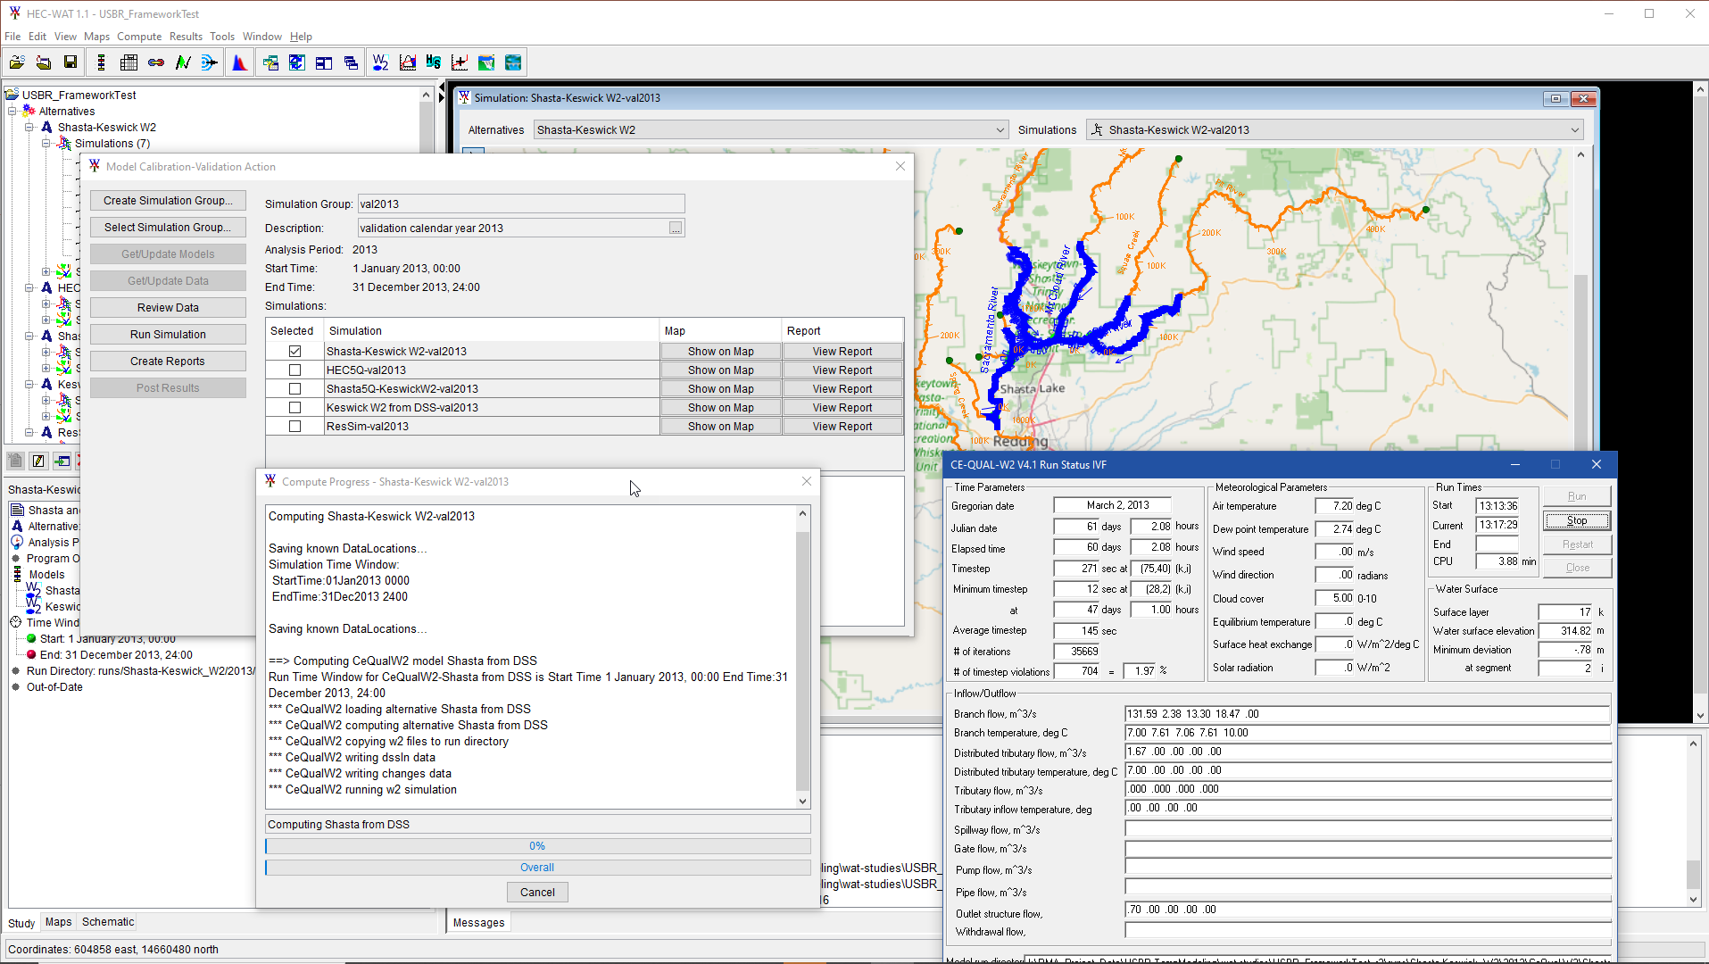
Initial Recommended Framework
HEC-Watershed Analysis Tool (HEC-WAT)
Product of the USACE Hydrologic Engineering Center
Freely Distributable
Supports local and Cloud based computation
Existing support for CE-QUAL-W2, HEC-ResSim, and HEC-RAS
Plug-in Application Programming Interface (API) for extension of modeling capabilities
Data Management
User Interface
Computational Model Support
Reporting
https://www.hec.usace.army.mil/software/hec-wat/

Slide 78
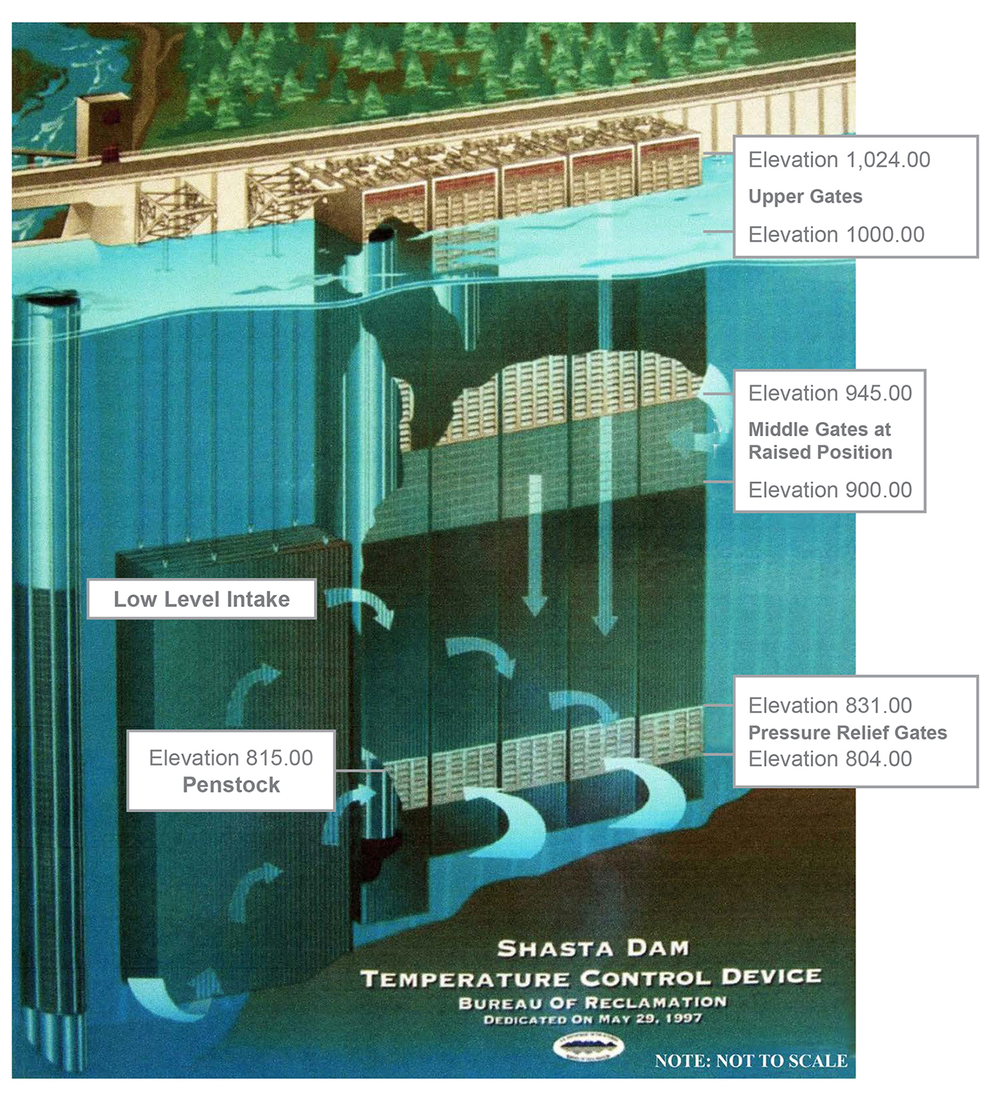
Questions

Slide 79
Short Stretch Break

Slide 80
Water Temperature Model and Framework Review and Selection - Trial Implementation of the Recommended Modeling Framework
Photo credit: John Hannon, Reclamation
John DeGeorge, Ph.D., P.E., RMA

Slide 81
Modeling Framework Test
Purpose of the Modeling Framework Test
Models in the Test
Use Cases
HEC-WAT Implementation
Workflow Action Plug-in
Input Data Review
Simulation
Automated Reports
Next Steps

Slide 82
Purpose of the Modeling Framework Test
Historical Observations
Demonstrate
Running several models from a common set of input data
Using a guided workflow to accomplish a modeling objective (“Use Case”)
Validation of a set of models using newly available data as the first example
Creating reports from several models using a common report format
Automated Pre-Processing
Automated Pre-Processing
Automated Pre-Processing
Model 1
Model 3
Model 4
Automated Pre-Processing
Automated Post-Processing
Automated Pre-Processing
Reports
Data Export
Excel, CSV, DSS…

Slide 83
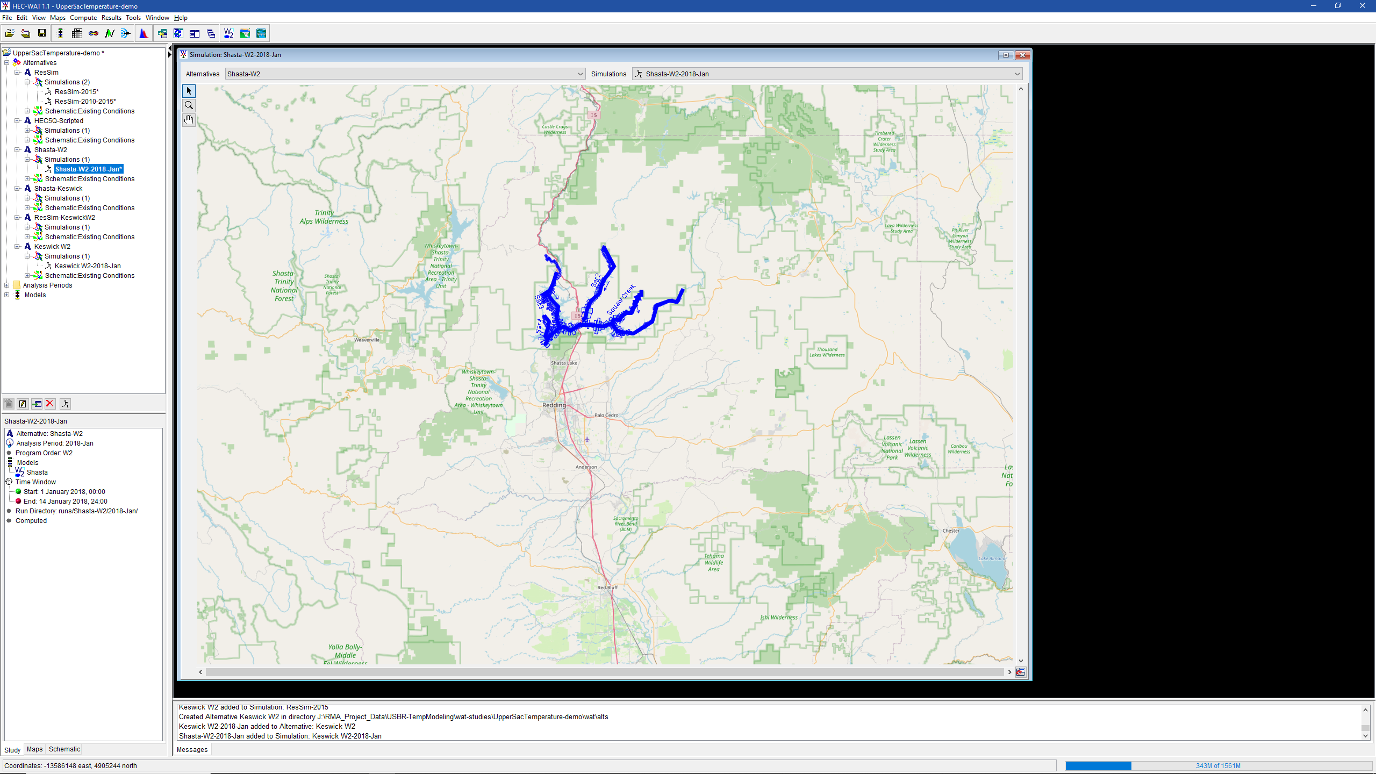
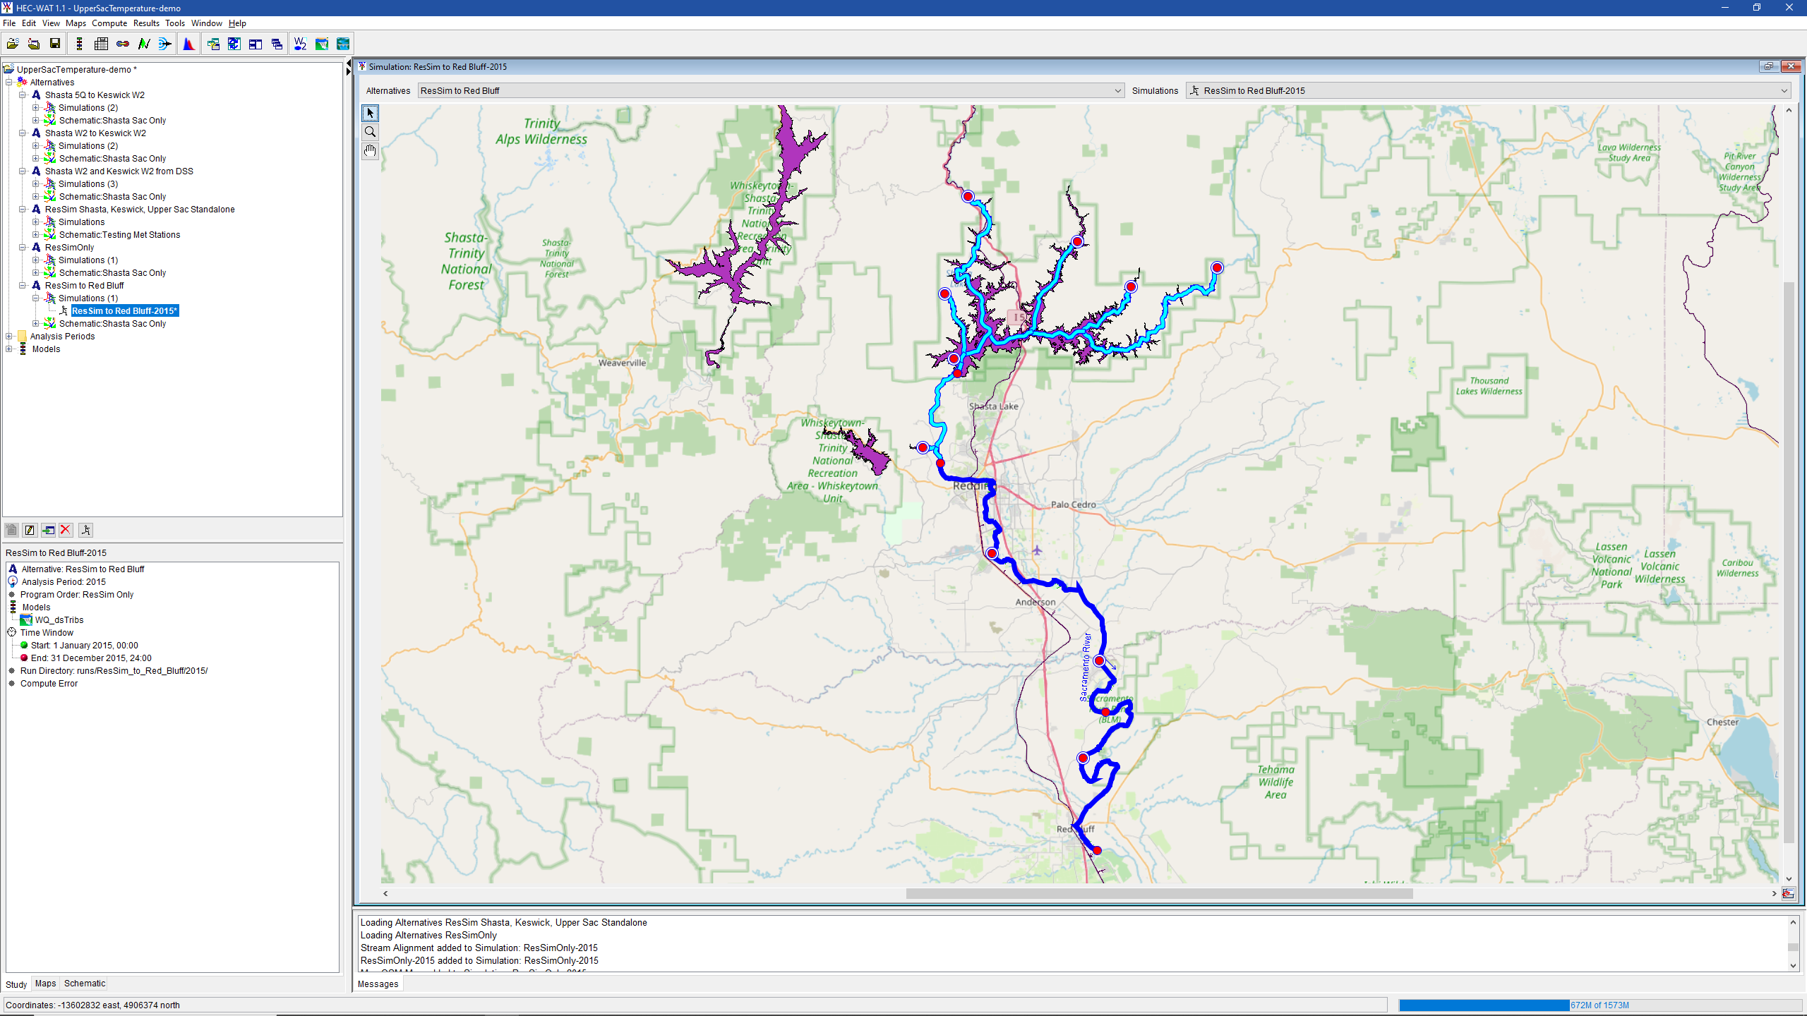
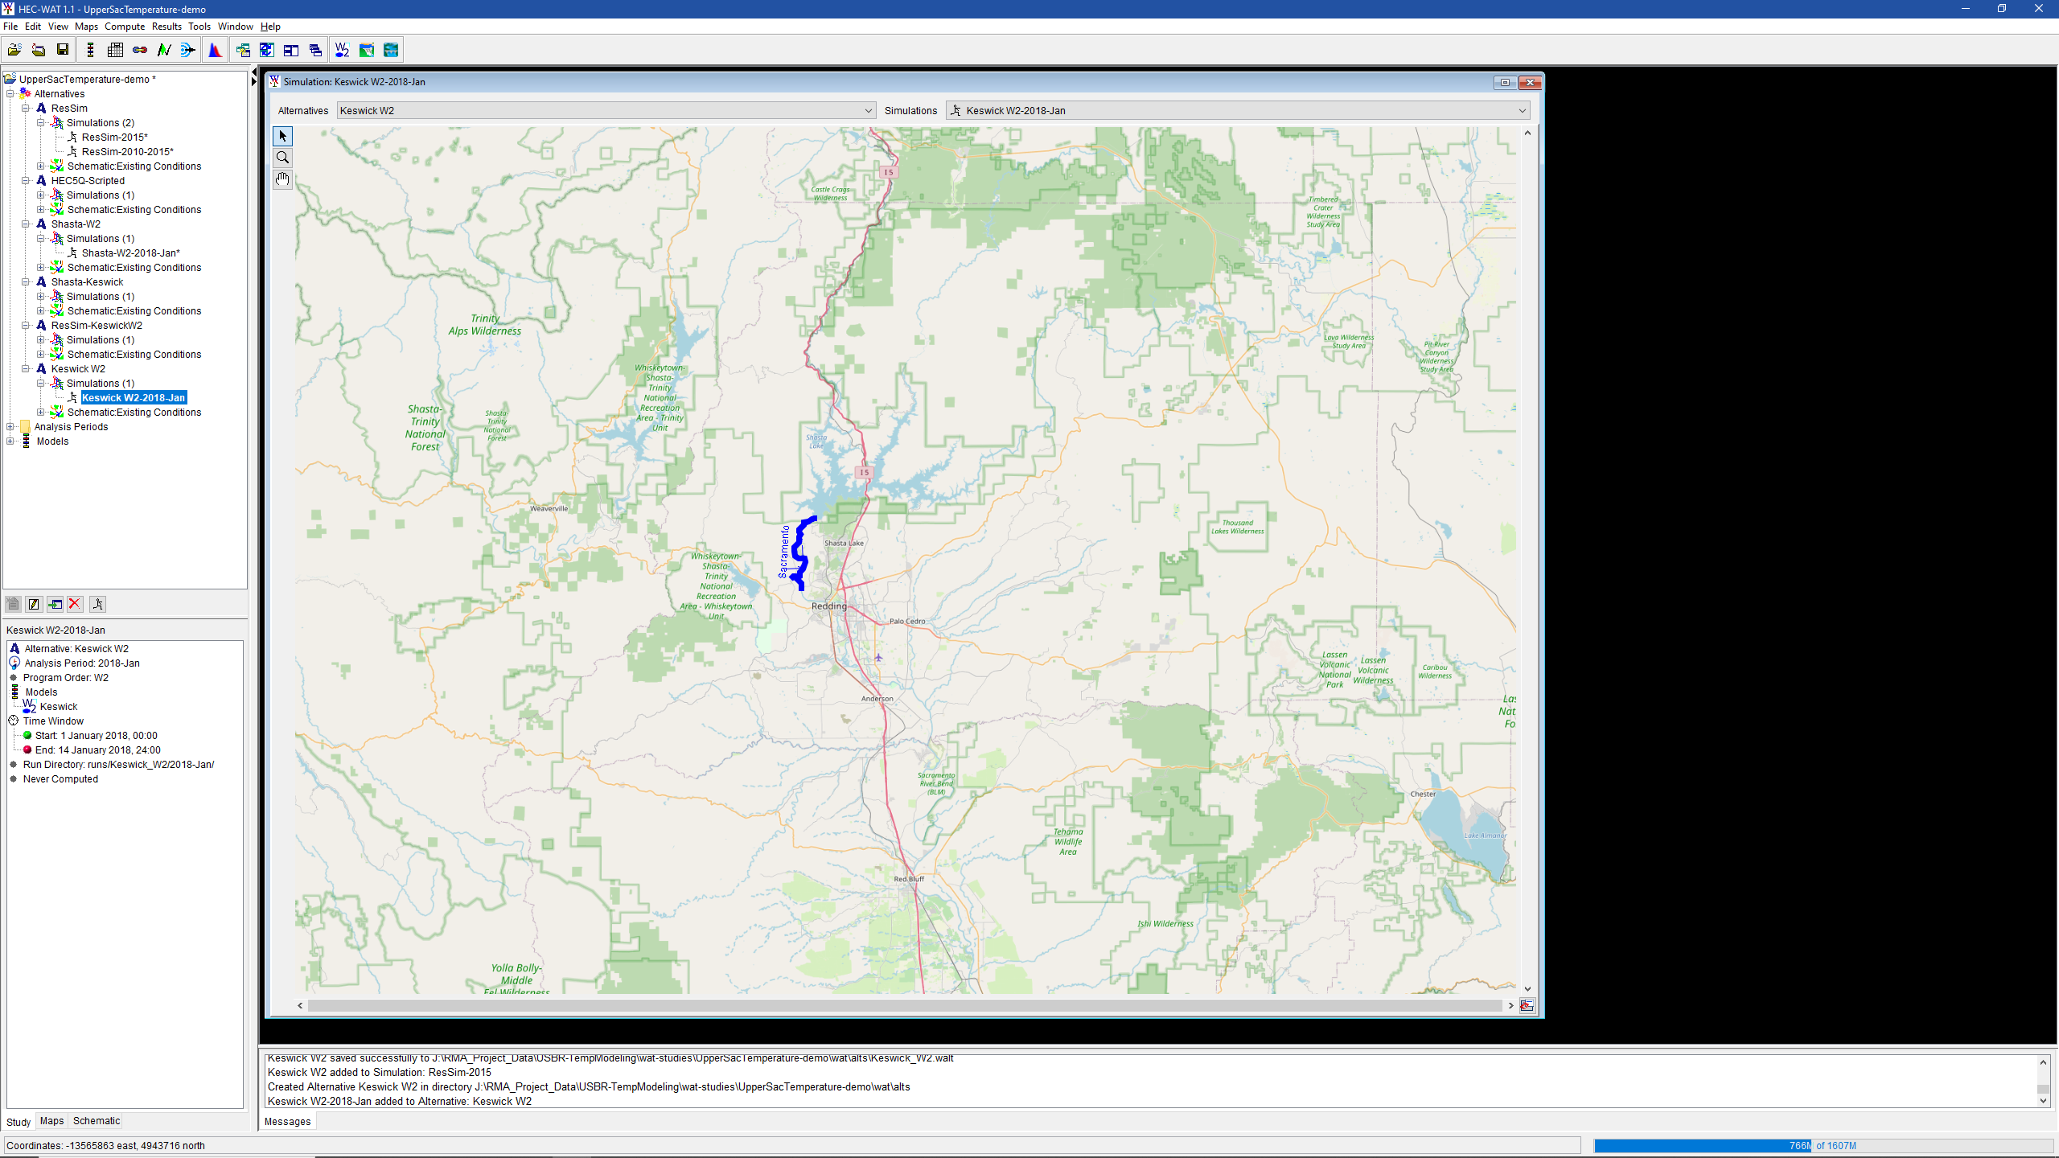
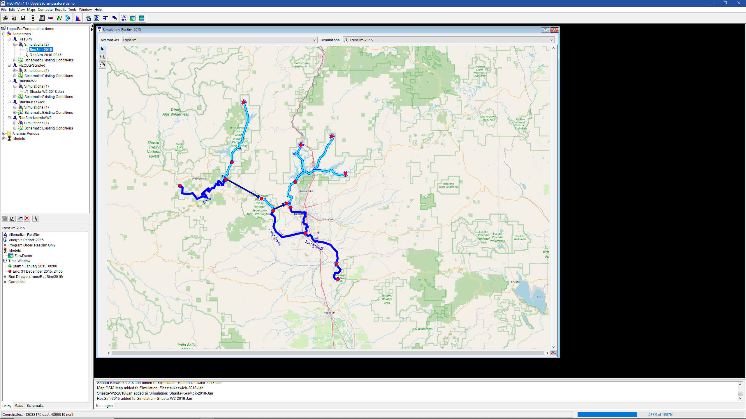
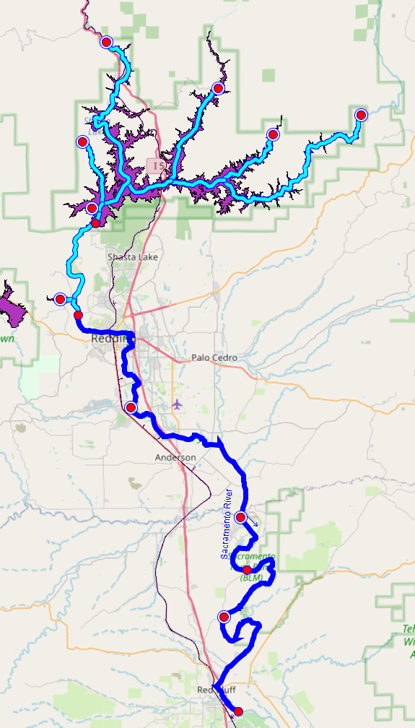
Models in the Test
CE-QUAL-W2, Shasta and Keswick Reservoirs
HEC-ResSim, Shasta and Keswick* Reservoirs, Sacramento River to Red Bluff
HEC-RAS**, Sacramento River to Red Bluff
HEC5Q***, Upper Sacramento System
*HEC-ResSim Keswick representation very simple at this point
**HEC-RAS WQ not yet tested
***HEC5Q results are provided for comparison
W2 Shasta
ResSim Shasta to Red Bluff
W2 Keswick
5Q Upper Sac System
(approx. schematic)

Slide 84
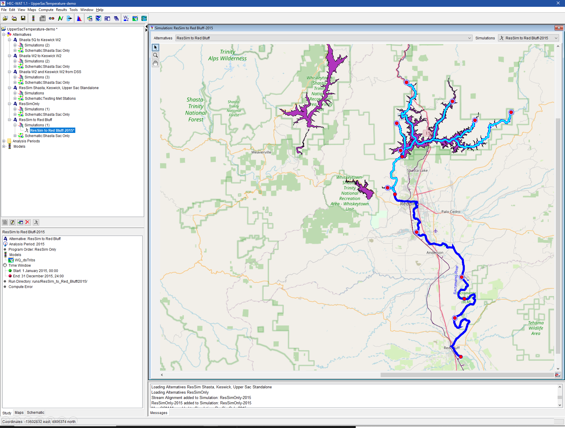
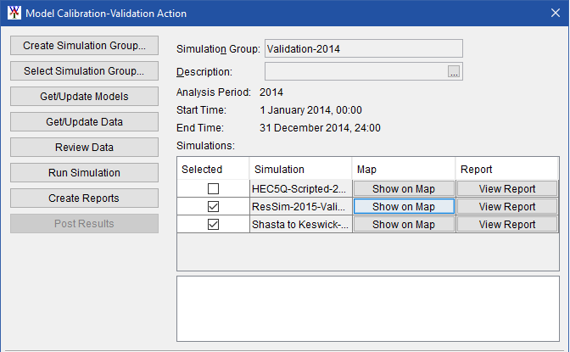
Activities associated with this Test
WAT plug-in development to manage validation use case workflow
Improvement of existing CEQUAL-W2 plug-in for HEC-WAT to support better support linking and reporting
Basic configuration of HEC-RAS Geometry and Water Quality model below Shasta
Basic configuration and calibration of HEC-ResSim water quality model for Shasta, Keswick, and upper Sacramento River to Red Bluff
Implementation of common reporting tool
Creation of an HEC-WAT study to support model validation simulations 2013-2016

Slide 85
Boundary Conditions
Time Series Data | W2 Shasta | W2 Keswick | ResSim | RAS | 5Q
Air temp | X | X | X | X
Dewpoint temp | X | X | X | X
Wind Speed | X | X | X | X | X
Wind Direction | X | X | X | X
Cloud Coverage | X | X | X | X
Shortwave Radiation | X | X | X | X | X
Equilibrium Temperature |  |  |  |  | X
Vertical Profile Initial conditions-Shasta | X |  | X |  | X
Vertical Profile Initial conditions-Keswick |  | X | X |  | X
Pit River Arm inflow time series | X |  | X
Squaw Creek Arm inflow | X |  | X
McCloud River Arm inflow | X |  | X
Sacramento River Arm inflow | X |  | X
Big Backbone Creek Inlet inflow | X |  | X
Pit River Arm temp | X |  | X
Squaw Creek Arm temp | X |  | X
McCloud River Arm temp | X |  | X
Sacramento River Arm temp | X |  | X
Big Backbone Creek Inlet temp | X |  | X
Combined Shasta Inflow |  |  |  |  | X
Combined Shasta Inflow Temperature |  |  |  |  | X
Shasta local balance flow | X |  | X |  | X
Shasta local balance flow temperature | X |  | X
Historical Shasta Outlet and TCD Operation** | X |  | X |  | X
Shasta outflow (Keswick Inflow) |  | X
Shasta outflow temperture (Keswick inflow temperature) |  | X
Spring Creek inflow |  | X | X |  | X
Spring Creek temperature |  | X | X |  | X
Keswick local balance flow |  | X | X |  | X
Keswick local balance flow temperature |  | X | X
Keswick outflow |  |  |  | X
Keswick outflow temperature |  |  | X | X
Clear Creek inflow |  |  | X | X | X
Clear Creek temperature |  |  | X | X | X
Other tributary inflows (Cottonwood, etc.) |  |  | X | X | X
Other tributary temperature (Cottonwood, etc.) |  |  | X | X | X
ACID diversion |  |  | X | X | X
Met. Data
Meteorologic Data
Shasta Inflows and Initial Conditions
Keswick Inflow, Inflow Temperature, and Initial Conditions
Upper Sacramento Inflow Flow, Inflow Temperature
Shasta
Keswick
Upper Sac.

Slide 86
Use Cases
Calibration
Validation
Sensitivity and Uncertainty Analysis
Temperature Management Plan Development
Planning Analysis
Ensemble Simulation
The example for today’s meeting is model validation

Slide 87
Model Validation Use Case Example
New observed data has become available and the existing model(s) need to be tested with the new data
Get updated data from the Data Management System (will be demonstrated later after further development)
Review the new data
Set up a new set of simulations for the period with new data
Perform the simulations
Create reports to document the ability of the existing models to reproduce observations
Post key results to the Data Management System (will be demonstrated after further development)

Slide 88
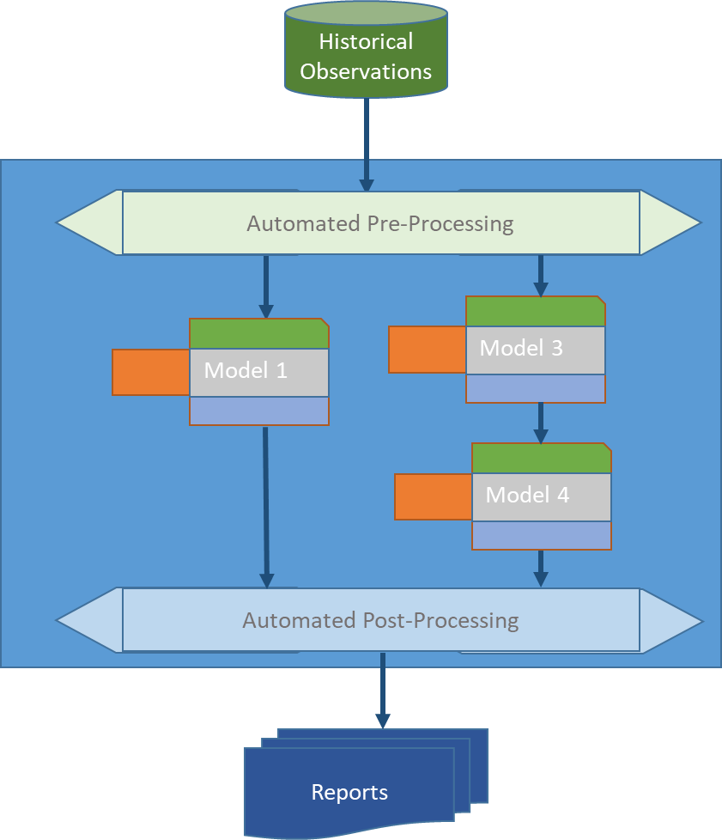
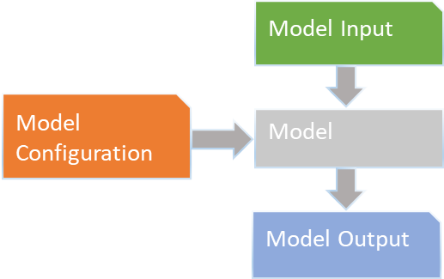
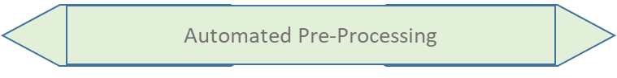
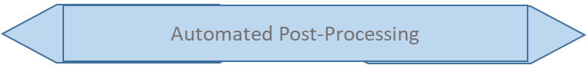
Model Data Management
File Management
Facilitated by Framework
Model 2
Model 1
Model 3
Configuration and Initial Calibration outside of Modeling Framework
Model Linking within the Framework
(“Base Simulations”)
Production runs supporting a Use Case

Slide 89
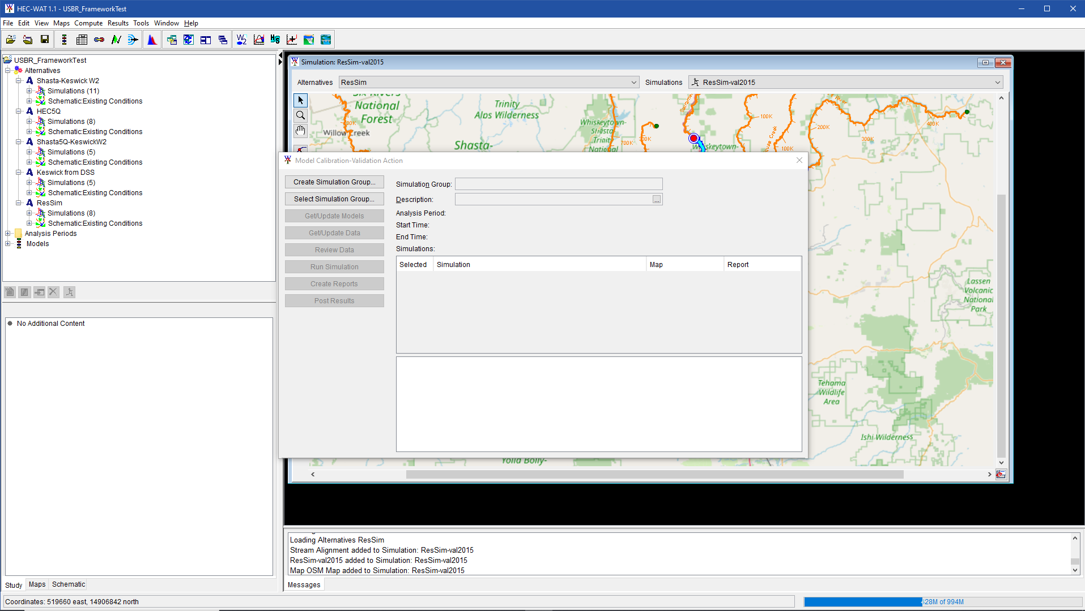
Demonstration Screens - Open the HEC-WAT Study
Previously Defined “Base Simulations”

Slide 90
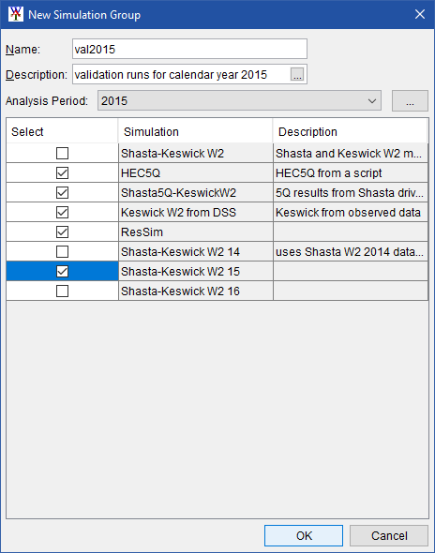
Demonstration Screens – Create a Simulation Group
Set the “Analysis Period”
Select “Base Simulations”

Slide 91
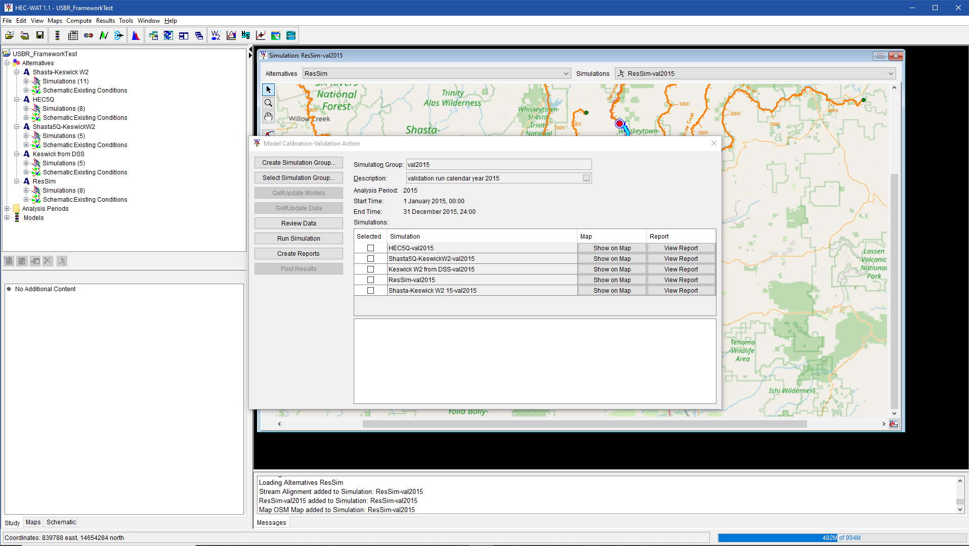
Demonstration Screens – Workflow Action Screen
Workflow “Actions”
Simulations in “Group”

Slide 92
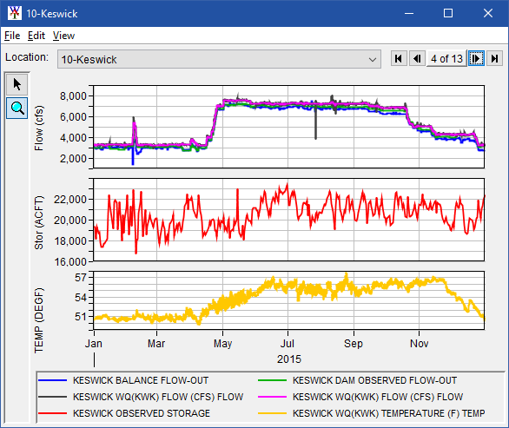
Demonstration Screens – Input Data Review
Review Data Action

Slide 93
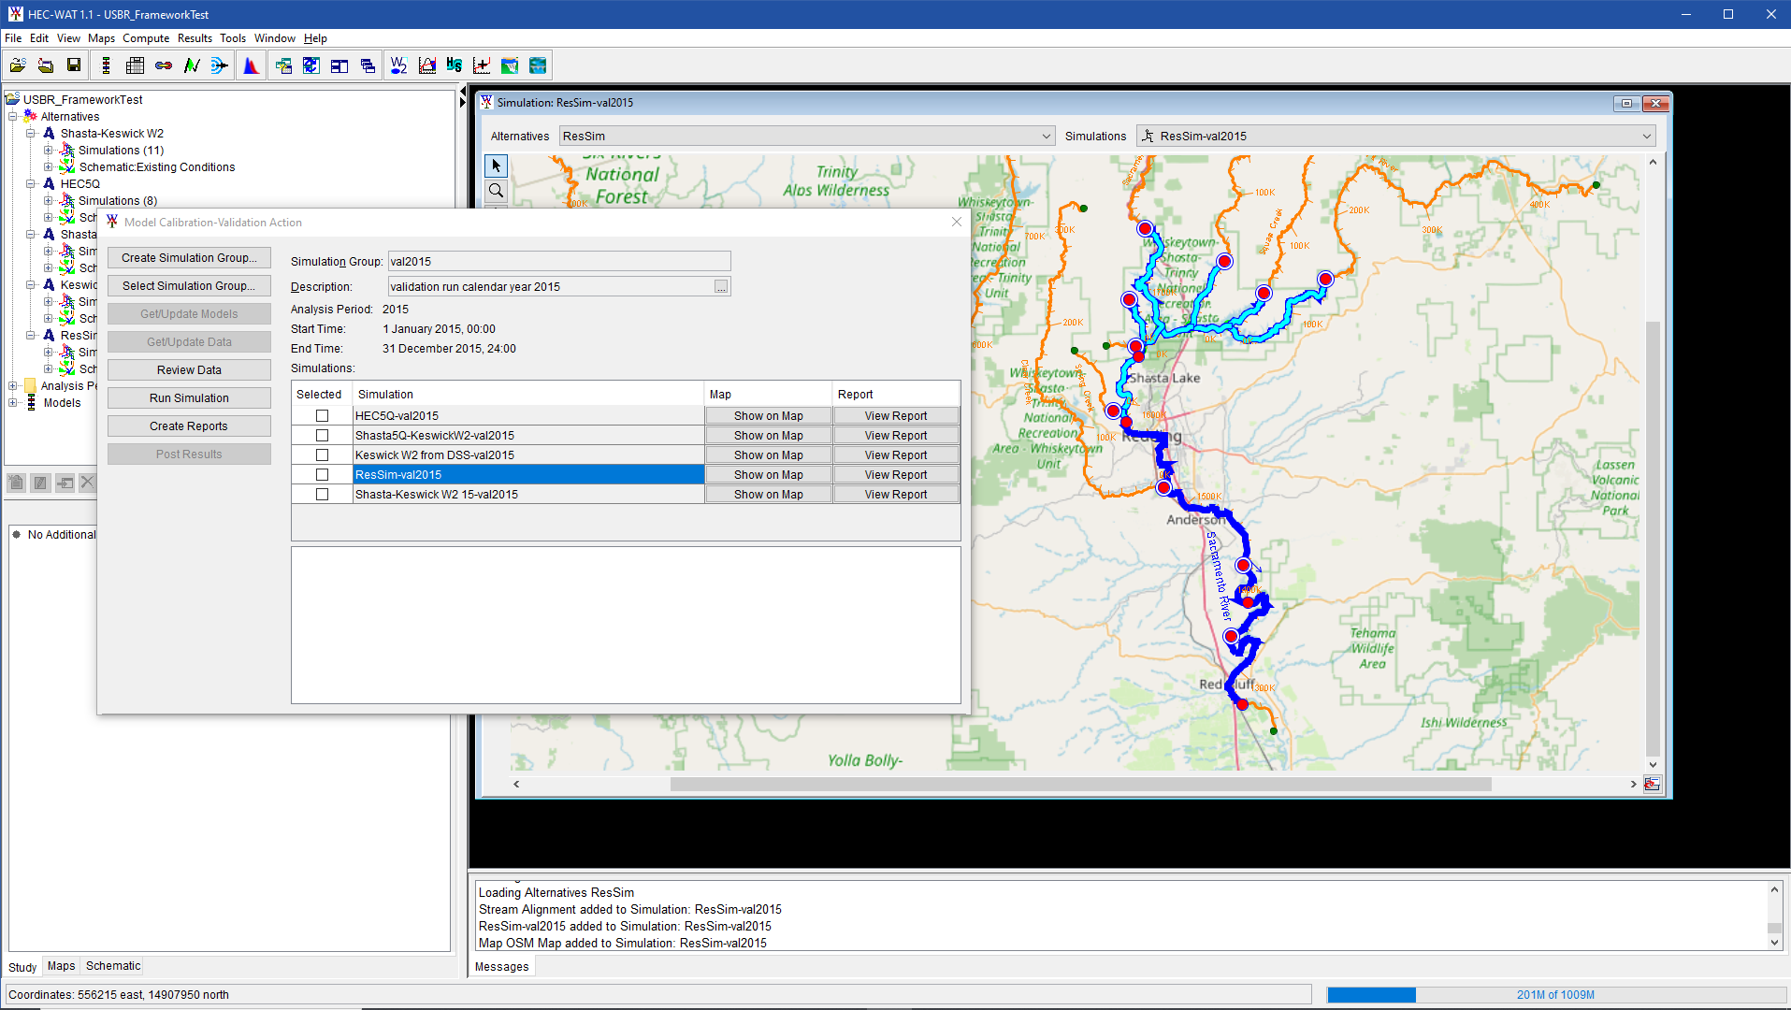
Demonstration Screens – ResSim Model Displayed
Show On Map

Slide 94
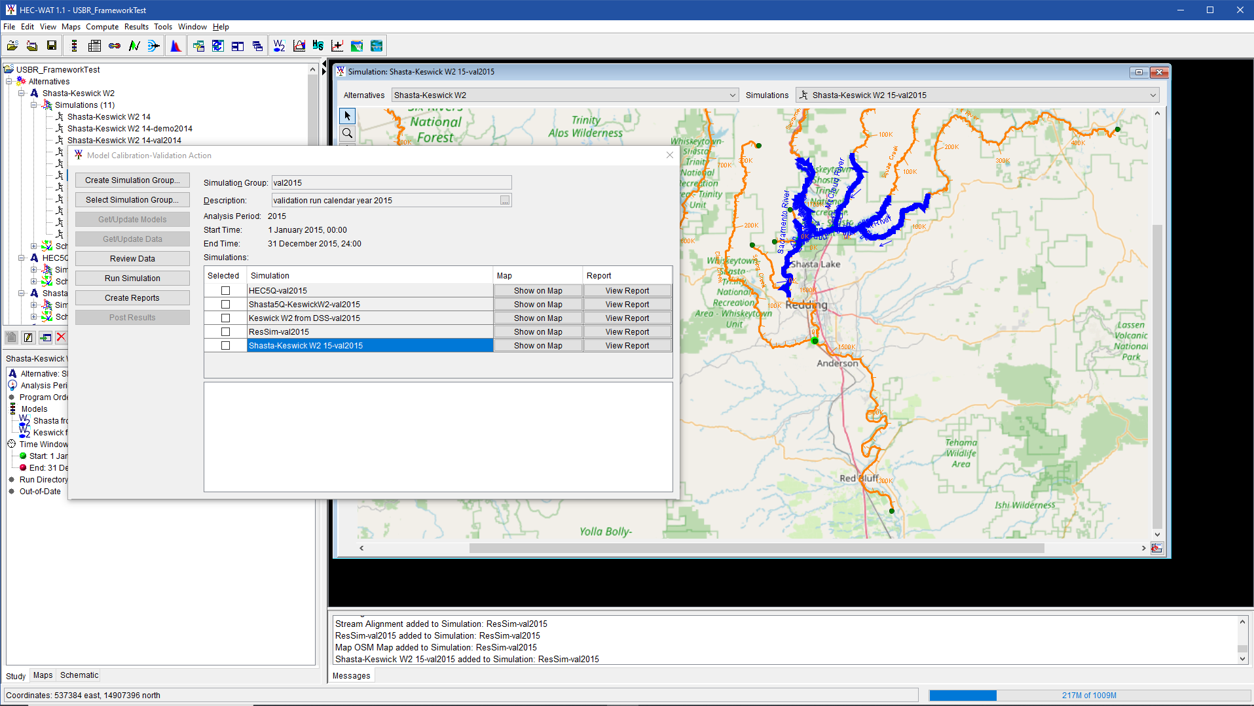
Demonstration Screens – W2 models Displayed
Show On Map

Slide 95
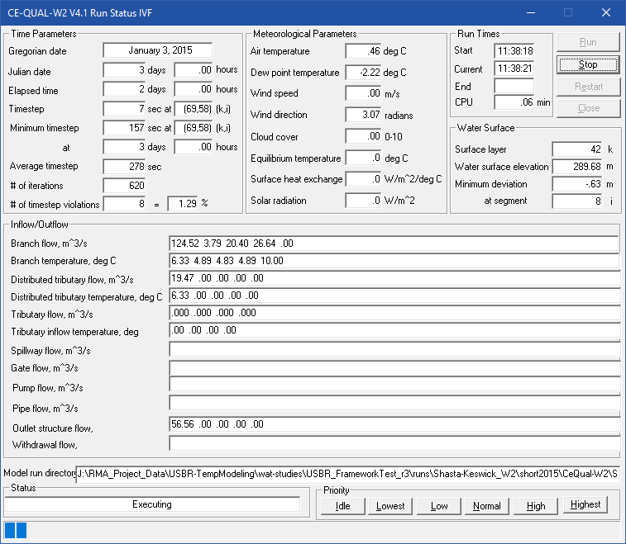
Demonstration Screens – W2 Compute Window
Run Simulation Action

Slide 96
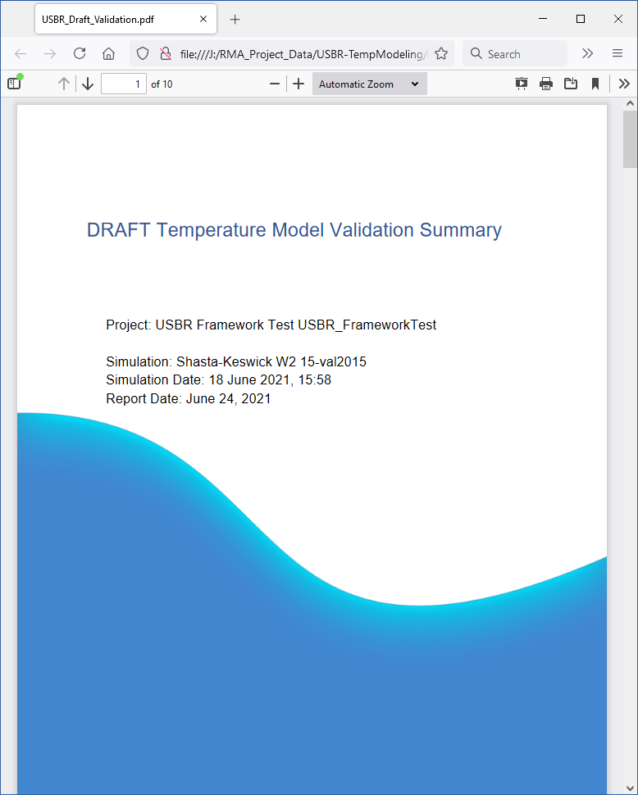
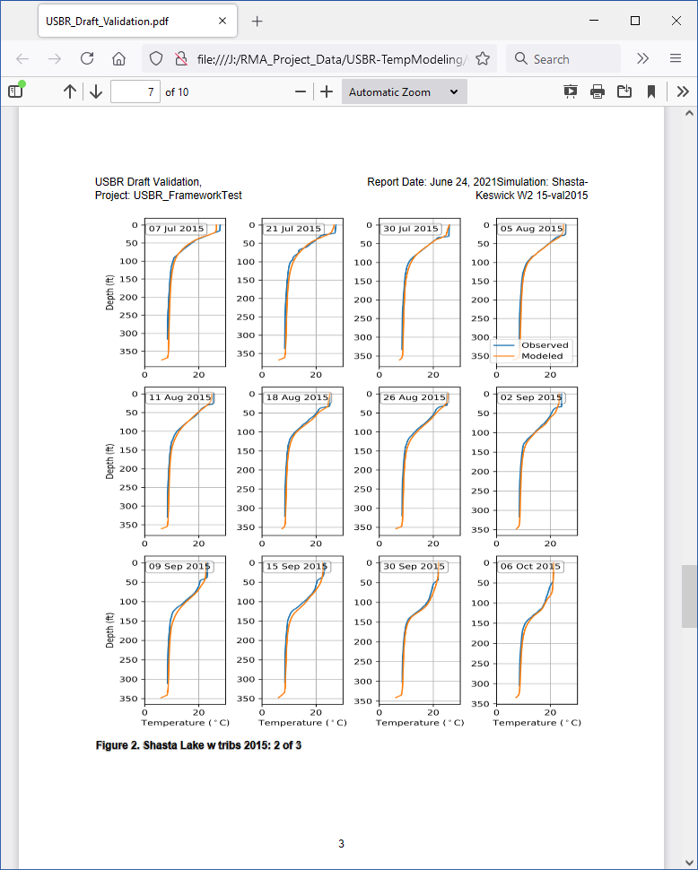
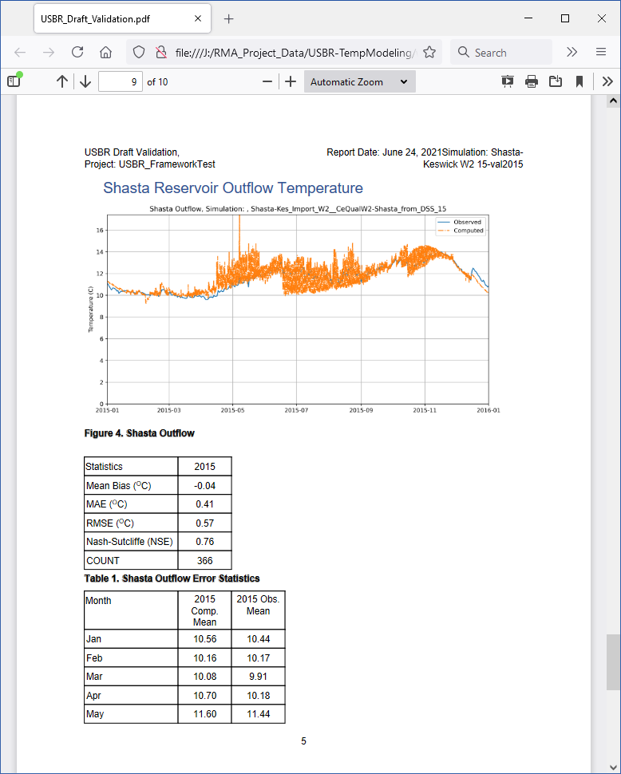
Demonstration Screens – Automated Report
Create Report Action

Slide 97
Enhancement to WAT Capabilities Design Opportunities
Extensions to be implemented using HEC-WAT Plug-in API
Use of Remote Data Source (extract and post from/to web data service)
Interface to Facilitate Production Use Cases
Automated Report Generation
Version (“Artifact”) Management for model computational code and configuration data sets

Slide 98
Summary Findings
HEC-WAT is capable linking and running the selected models in HEC-WAT
Approximate Computation time for 1 year of simulation
HEC5Q - ~10 seconds (6 hour time step)
CE-QUAL-W2 Shasta - ~15 min
CE-QUAL-W2 Keswick - ~20 min
HEC-ResSim - ~45 seconds (1 hour time step)
Accuracy of the models has not yet been evaluated in detail, further testing in progress
Initial development of a Use Case Workflow plug-in for HEC-WAT was successful
Initial implementation of common reporting was challenging, but shows promise

Slide 99
Next Steps
Refinement of model linking and improvement of model plug-ins to support time dependent operation control
Common reporting design and model result post-processing to support additional report formats
Definition and representation of additional use cases
Further calibration of new models
Appropriate design to provide correct level of user customization and long-term maintenance
Toward Deployment
Integration with Data Management System
Refinement of model/data management concepts to support coordinated team modeling by Reclamation staff and other collaborators
Version management for software and model configuration data

Slide 100
Questions

Slide 101
Wrap Up and Next Steps
Photo credit: John Hannon, Reclamation
Randi Field, CVO
Yung-Hsin Sun, Stantec

Slide 102
Upcoming MTC and Topics
Next MTC Meeting: October 7, 2021; 1 – 4 pm
Upcoming topics:
The email for signing up will be out soon – registration required.

Slide 103
Information Sharing and Contacts
Project contact: mppublicaffairs@usbr.gov
Key team members presenting today
Randi Field, RField@usbr.gov
Mike Deas, Mike.Deas@watercourseinc.com
John DeGeorge, jfdegeorge@rmanet.com
Yung-Hsin Sun, yung-hsin.sun@stantec.com
Stakeholder Information SharePoint Site Access:
Site address
Registered participants will be added for access. Any challenges: sarah.hamilton@stantec.com
Long-term: 184031386@stantec.com

Slide 104
Happy July 4th picture

Slide 105
NEXT MTC MEETING: October 7, 2021; 1 – 4 pm

